Slide 1
CogSci 150 “Sensemaking and Organizing” Spring 2022
Robert J. Glushko
glushko@berkeley.edu
21 April 2022
26) Computational Description

Slide 2
Course Endgame
TODAY (4/21): “Computational Description”
Class party at Jupiter, 6-7pm
TUESDAY (4/26): “Computational Classification”
THURDAY-FRIDAY (4/28-29) 2nd EXAM
TUESDAY 5/3: Case Study Presentations
THURSDAY 5/5: Case Study Presentations
FRIDAY 5/6: Last Day for “Free Read” of Case Study Report (you get comments back by 5/7)
TUESDAY 5/10: Case Study Reports Due

Slide 3
Case Study Presentations
TELL A STORY ABOUT YOUR ORGANIZING SYSTEM in 5 minutes
No more than 3 slides; one should be the “artifact” that conveys the biggest ideas and that you’ll spend the most time explaining
If you still need some inspiration, flashback to “Models for Organizing Systems” in 1/25 lecture
You will need to turn in your slides by 10am on the day of your presentation so we can put them into a single file
Don’t mindlessly follow the design questions outline – emphasize the ones that are most important for your organizing system
Be careful - the “how” question is about organizing principles, not the amount of organization (there is some confusion in older case studies)
Sign up for your time slot on 5/3 or 5/5 in the Google Doc in today’s announcement

Slide 4
Today’s Lecture
“Describing Documents” – the connection between “Information Retrieval” and “Data Science”
Creating categories from descriptive statistics
“Text processing” to find the best words to describe documents
The Boolean model
The Vector model

Slide 5
The last two lectures on Computational Description and Computational Classification are an insane attempt to compress a semester of information science and machine learning topics into two lectures
My goal is to help you see how these topics fit into the discipline of organizing, not to fully explain them in much detail (which is why we the 2nd exam will barely touch these topics in qualitative and not quantitative ways)

Slide 6
Creating Resource Descriptions
FLASHBACK
By authors/creators: Best knowledge of purpose and intended audience
By professionals: "Institutional" descriptions that follow standards are likely to be more accurate, precise, consistent
By users: Most variable, influenced by social purposes
By automated processes (TDO 5.4, 7.5.3…): essential with large collections and when time is critical
6

Slide 7
Comparing Resource Descriptions
All information retrieval systems compare a description of a user’s needs with descriptions of the document resources that might satisfy them
“Relevant documents” are the category to which the search query and retrieved information (document) both belong
Likewise, any “classifier” whose purpose is to determine the category to which a resource belongs must compare the resource description with some description or representation of the category

Slide 8
Describing Documents - Motivation
Small collections might be adequately described by traditional bibliographic descriptors based on intrinsic properties (author, title) or with assigned keywords
But these aren’t semantically precise enough to distinguish documents in large collections
Extracting a set of terms for describing the documents in a collection is the foundation for information retrieval
8

Slide 9
Glossary: Information Retrieval
The “IR model” specifies the representations of queries and documents in the collection being searched
Does this remind you of “Category Structure” – the specification of the tests for category membership?
“Text processing” extracts and merges multiple word forms into a single form or “index term”
The set of terms in a search query or document to be matched is compared against the term representation that describes each document in the collection
9

Slide 10
“Category Structure” (Principles for Creating Categories)
FLASHBACK
Enumeration
Single Properties
Multiple Properties
Similarity / Family Resemblance
Theory-Based (or Analogy-based)
Goal-Derived (or Activity-based)
10

Slide 11
Glossary: Data Science & Machine Learning
The process of choosing a set of properties or attributes of resources is called “Feature Selection”
When multiple candidate properties or attributes are combined into a new feature this is “Feature Engineering” or “Feature Extraction”
Determining how these features are used to classify or predict something is called “Model Construction”
11

Slide 12
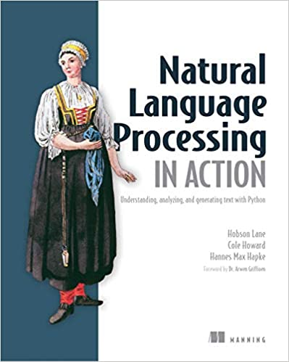
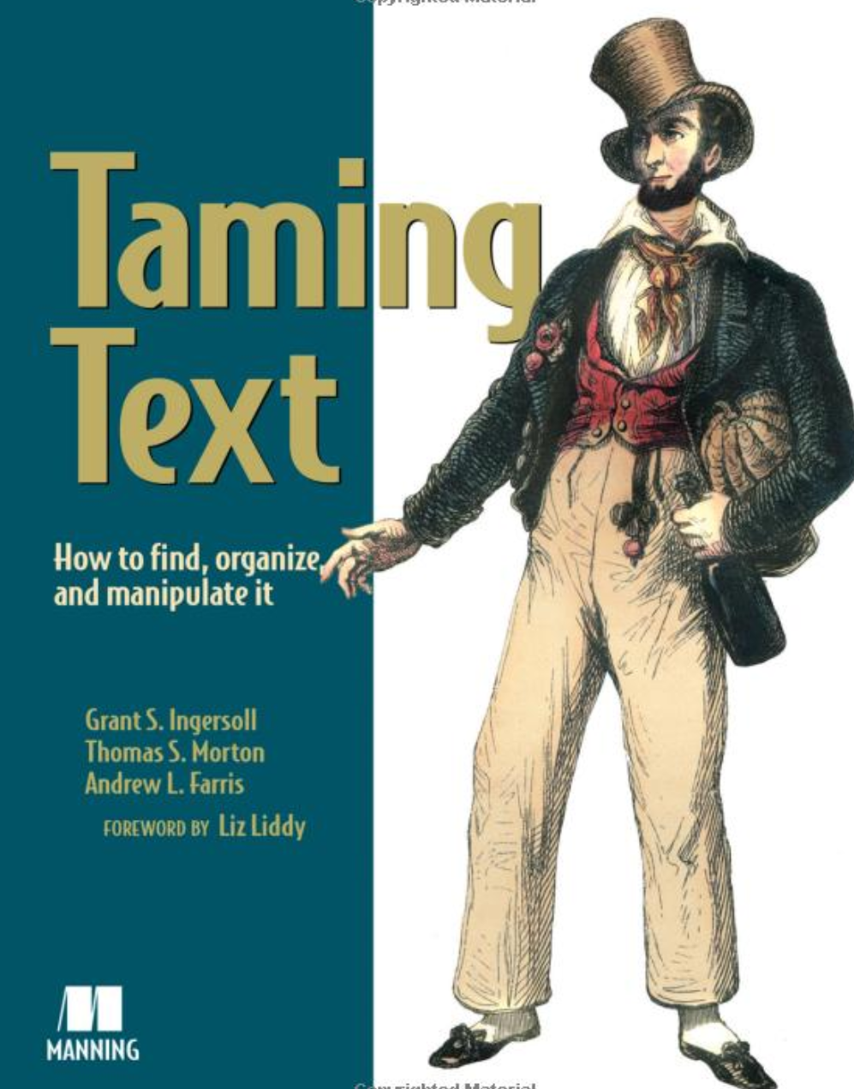
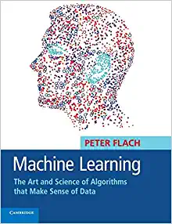
Recommended Texts

Slide 13
Computational Resource Description
Some of this material is discussed in TDO 10.3 and 10.4, which I didn’t assign because its tone is a little dated (a lot has changed in the last 7 or 8 years, especially wrt “deep learning” and “neural networks”)
But I think it useful to understand some of the history of how people have tried to “make computational sense” of language

Slide 14
Categories from Descriptive Statistics (1)
The simplest way to create categories is to compute descriptive statistics and histograms for property values
These reveal if there is any useful or meaningful variation that could be the basis of an organizing principle that distinguishes resources in interactions with them
A lot of data science starts by doing this with a large number of properties at the same time, not just one at a time (“Feature Selection”)

Slide 15
Stop And Think
Let’s compute some statistics… is there “useful” variation that we can use to organize some set of resources?
If I measured the heights of everyone in this class, there is enough variation to make it possible and perhaps useful to arrange you by height (for what purpose?)
If I measured the diameter of your head…
15

Slide 16
Categories from Descriptive Statistics (2)
The interpretability of the categories is limited by the levels of measurement embodied in the property value, which determines how much quantitative processing makes sense
Even for nominal level data that has no intrinsic order (values are labels or identifiers), it can be useful to organize resources according to the frequency of specific property values; the MODE is the most frequently occurring one

Slide 17
Categories from Descriptive Statistics (3)
If property values are ordinal level data, resources can be organized from the lowest to highest property value; the middle value of a list sorted this way is the MEDIAN
The median divides the values into two categories with the same number of members; we can generalize this idea to create any number of equal-size categories:
Percentiles(100 categories), deciles (10), quartiles (4)
You can also create named categories from ordinal properties (low, moderate, high cost; new, almost new, old, very old…)

Slide 18
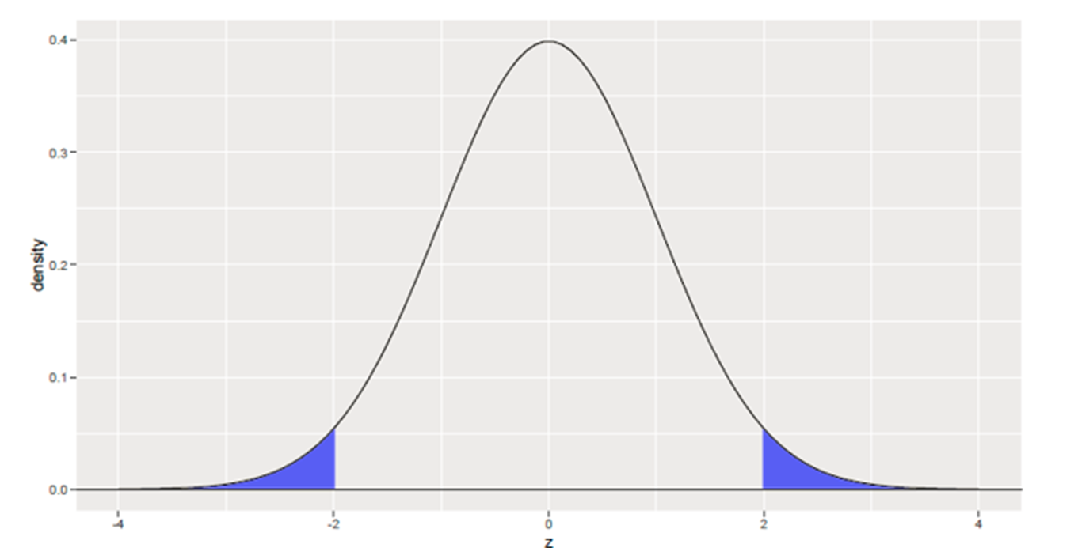
Categories from Descriptive Statistics (4)
If property values are interval level data, it is meaningful to calculate the distance between values, and the MEAN or AVERAGE is the value for which the sum of the absolute distances to each other value is 0
We can create resource categories using the probability of their property values (e.g., as measured in STANDARD DEVIATIONS)
“Generic” Labels:
Values with prob < .05
are “Outliers”
“Six Sigma” defects occur
with a prob < .00066

Slide 19
Stop And Think
The MEDIAN is often a better summary description of a statistical distribution than the MEAN (or AVERAGE)
If ten people are in a bar, all of whom make $50,000 a year, when a movie star who made $25,000,000 this year walks in, the average in come is now $2.3 million. The median income is still $50,000
19

Slide 20
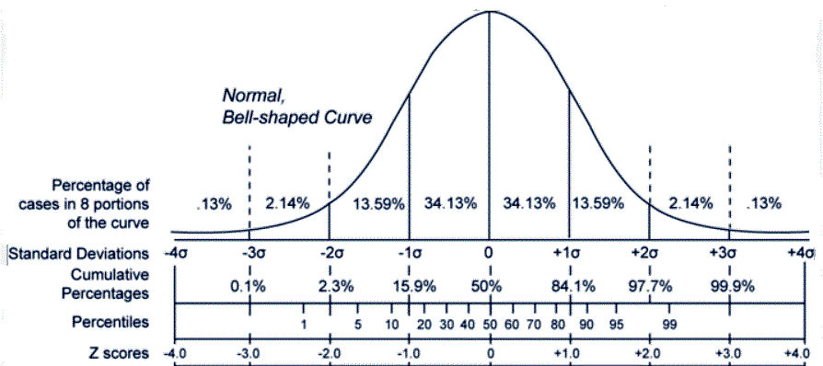
“Unlabeled” Categories from Descriptive Statistics
20

Slide 21
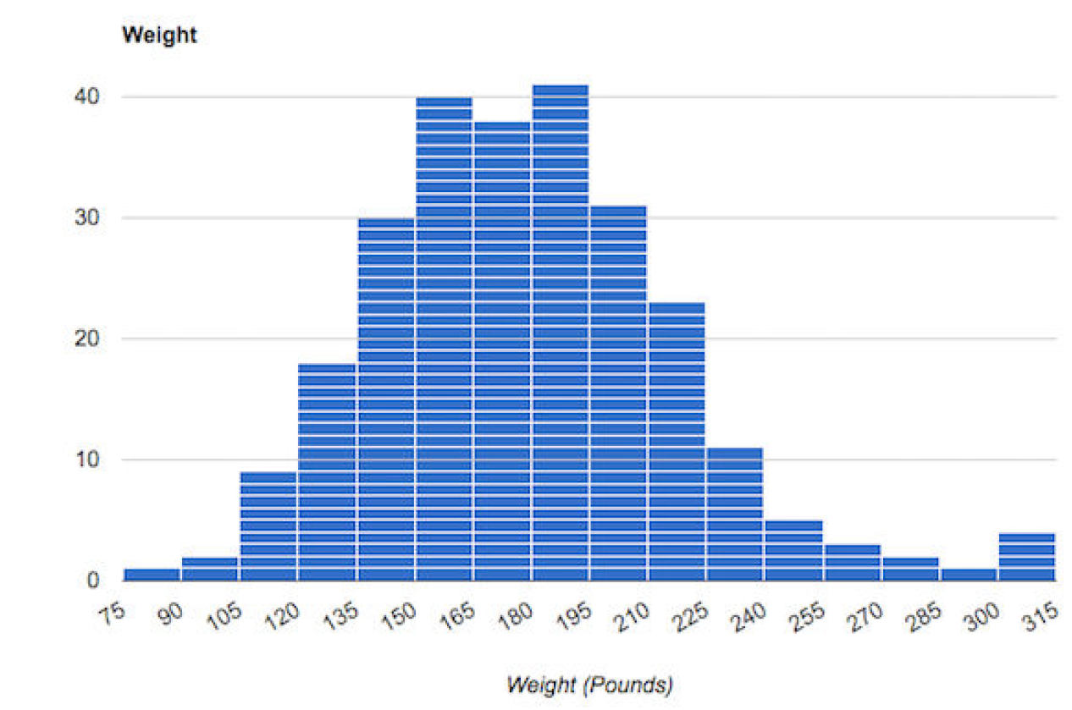
ALWAYS LOOK at the Data!
Descriptive statistics are useful, but you should always look at the data because that shows things not revealed in the statistics
Bimodality -> two categories of observations?
End of range anomaly -> measurement limitation?

Slide 22
Anscombe’s Quartet
Could these 4 datasets look any more different?

Slide 23
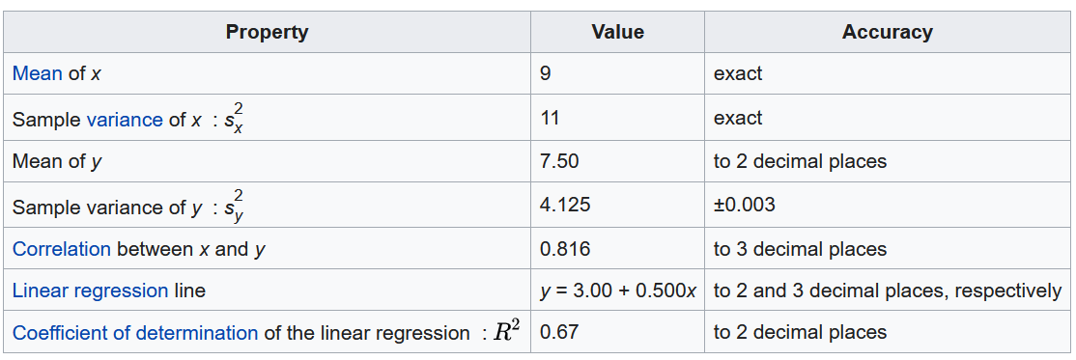
Anscombe’s Quartet
All 4 datasets have identical or nearly identical descriptive statistics

Slide 24
Categories from Simple Descriptive Statistics Can be (Intentionally) Biased
You (or someone else) chose a unit of analysis (“What resources are being organized?”) for which the property values are measured
Changes in category granularity can introduce large changes in the values of descriptive statistics
Put another way… you can often devise a category system for which your descriptive statistics can tell a biased story

Slide 25
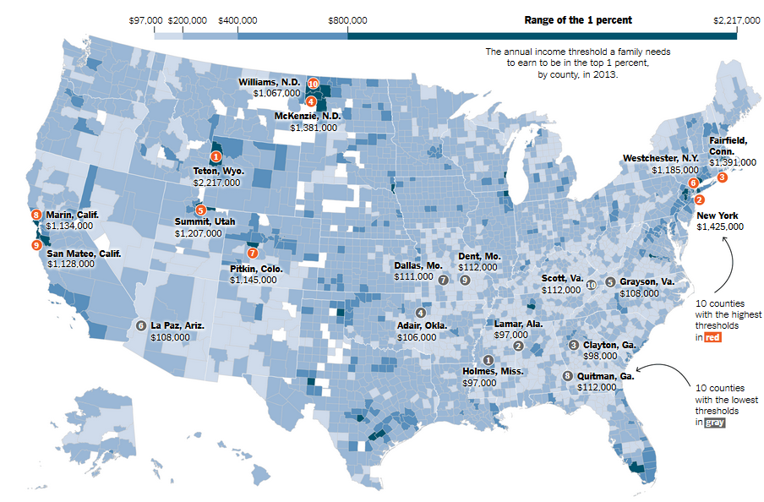
Income Categories: Find the “1-percenters” in the US

Slide 26
“Income Inequality” Categories
In some parts of the US, you need to make >$2M to be in the 1% (Jackson Hole, Wyoming)
In Mississippi the 1% category is less than $100K – less than the MEDIAN salary in the Bay Area
In the world as a whole, a $47K annual income would make you a 1-percenter
Which makes the people in the US complaining about income inequality seem a little spoiled and whiny!

Slide 27
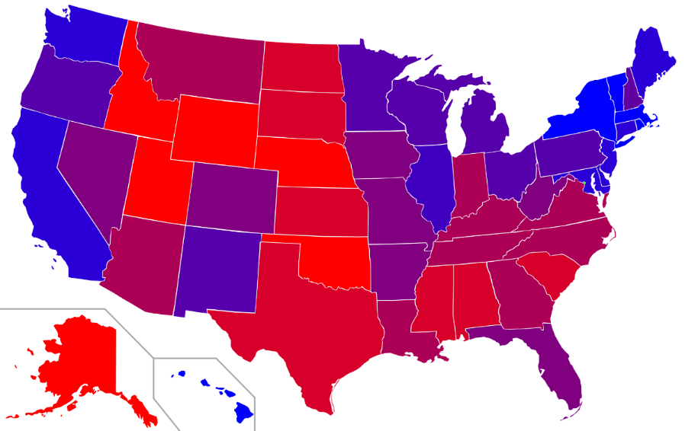
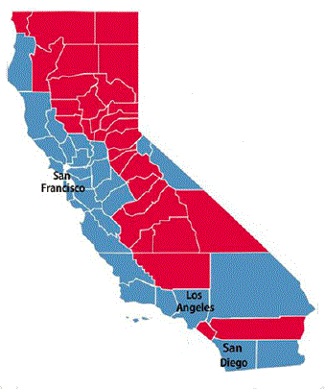
“Choropleth Maps” -- Red and Blue States vs. Red and Blue Counties
Changing the category granularity tells a very different story
California - a “Blue State” (last 4 presidential elections)
But only the urban counties and Lake Tahoe are actually Blue

Slide 28
Using Words to Describe Documents
What words best describe
a document?

Slide 29
Why we need more than “just the words”
If we want to know what a document is about, we could look at all the words to see if any of them are the topics we are interested in
But linear search through a document takes O(n) time, where n is the length of the document or document collection
This is infeasible for all but trivially small collections, so we need descriptions of documents that are much smaller than the documents!

Slide 30
What Words Best Describe a Document? (1)
Not all words are equally useful indicators of what a document is about; many are irrelevant or redundant
Nouns and noun groups carry more "aboutness" than adjectives, adverbs, and verbs
Very frequent words that occur in all or most documents add NOISE because they cannot discriminate between documents
30

Slide 31
What Words Best Describe a Document? (2)
For any large document collection, it is necessary to pre-process the text of documents to select / create a smaller set of terms that better represent them; in IR these are called the INDEX terms
This selection and processing creates a controlled vocabulary for describing the contents of a document collection (with all the costs and benefits of CVs you know from earlier in the semester)
31

Slide 32
Extracting the “Words”
(btw, we haven’t defined “word” yet…)
A digital resource is a sequence of bits
How does this sequence of bits become words?
How does this set of all the words in a document become the much smaller set that usefully describes it?
THE ANSWER: “Text Processing”

Slide 33
Text Processing: Operational Overview (1)
The first two steps are very straightforward and “languageness” doesn’t matter for them
DECODING -- extracting the text to be processed from its stored representation, turning the bits and bytes into characters in some language by following the text encoding specification (e.g., UTF-8)
FILTERING -- creating a stream of characters by removing formatting or non-semantic markup
33

Slide 34
Text Processing: Operational Overview (2)
It is more important to focus on the processes where “languageness” matters:
TOKENIZATION -- segmenting the character stream into linguistic units
NORMALIZATION -- creating “terms” – categories of all the tokens with superficially different character sequences
34

Slide 35
Text Processing: Operational Overview (3)
STEMMING -- removing affixes and suffixes to allow the retrieval of syntactic and morphological variations of query terms
STOPWORD ELIMINATION -- remove words that poorly discriminate between documents
SELECTING INDEX TERMS -- choosing terms (or groups of them) as indexing elements
35

Slide 36
Tokenization
Identifying the “linguistic units” is another problem that seems trivial -- just use white space, right?
But what about:
abbreviations (Dr. is a word)
hyphens (sometimes part of a word, but sometimes a result of formatting)
36

Slide 37
Tokenization Challenges [1]
Many character strings include complex alphanumeric structure or punctuation syntax:
glushko@berkeley.edu
10/26/53
October 26, 1953
55 B.C
B-52
501(c)(3)
128.32.226.140
My PGP key is 324a3df234ch23e
https://bcourses.berkeley.edu/courses/1500399/
37

Slide 38
Tokenization Challenges [2]
The language that the characters represent needs to be identified during decoding because it influences the order and nature of tokenization
In languages that are written right-to-left like Arabic and Hebrew, left-to-right text can be interspersed, like numbers and dollar amounts
But how do you identify the language? That’s a classification problem that we’ll talk about in the next lecture
38

Slide 39
Tokenization Challenges [3]
In German compound nouns don't have spaces between the tokens
Many Asian languages combine ideographic symbols that can stand alone or be combined
Analogy in English:
TOGETHER could be interpreted as a single word or as its constituent words: TO GET HER
39

Slide 40
Stemming (and “Lemmatization”)
Many languages have some inﬂectional and derivational morphology, where similar words have similar forms:
organizes, organized, organizing
Stemming and lemmatization reduce this variety to a single common base form by “chopping” off the inflections
organizes, organized, organizing → organize

Slide 41
Normalization [1]
Often two character sequences are not the same, but you want to treat them as equivalent
Capital and lower-case characters are typically "case-folded" or “downcased” to lower-case
This enables you to find matches at beginning of sentences, but watch out for proper names like General Electric, Bush, and Ford which should not be case-folded
41

Slide 42
Normalization [2]
Apostrophes, hyphens, accents, and diacritics are often removed
anti-discriminatory and antidiscrimatory, cliché and cliche
But in some languages, diacritics distinguish words
pena and peña mean different things in Spanish
42

Slide 43
Selecting Index Terms
At this stage in text processing the text collection is represented as a set of stems or phrases
But not all of them should be kept; some will retrieve too many, and some too few documents
We can select better index terms if we analyze the frequency distribution of the words in the collection
43

Slide 44
Stop or Noise Words [1]
Any word that doesn't convey meaning can't help us "find out about" anything so it can be discarded
In English these STOP or NOISE words include:
determiners, such as "the" and "a(n)"
auxiliaries, such as "might," "have," and "be"
conjunctions, such as "and," "that," and "whether"
degree adverbs, such as “very” and “too”
How frequent are these words? What percentage of the words in a typical English-language document do the 10 most frequent words account for?
44

Slide 45
Stop or Noise Words [2]
The 10 most frequent words in English can account for 20% of the words in a document; you've never noticed that because they are everywhere
These words are always among the most frequent in a collection
Stop or noise words are usually not determined by frequency analysis – they are used as a kind of negative dictionary; it a word in in this dictionary it gets discarded
But we can’t completely ignore these words. Why not?
45

Slide 46
“To Be Or Not To Be”
A phrase is a group of words treated as a unit because the meaning of its constituent words don’t combine into the meaning of the phrase
"birth control" is not "birth" + "control"
"venetian blinds" are not visually disabled Italians
Phrases can be identified "by hand," using grammatical analysis, and by a "try everything" or “collocation extraction” automated approach that finds phrases that occur with non-negligible frequency
46

Slide 47
The Boolean Model of Document Description

Slide 48
The Boolean Model
The Boolean model represents documents and queries as sets of index terms that are either present or absent
This is a “bag of words” – no sentence structure or languageness remains
Term frequency is not represented in any way; terms are either present or absent
This enables comparisons between queries and document collections using set theory operations with Boolean algebra, making relevance a binary decision
THIS “IR MODEL” IMPLEMENTS ONE OF THE MODELS OF “CATEGORY STRUCTURE” (3/29 lecture) … WHICH ONE?
48

Slide 49
Classical Categories
FLASHBACK
“Classical” categories can have large numbers of category members, but they have clear boundaries defined by a small number of ESSENTIAL or necessary and sufficient properties
Necessary means that every instance must have the property to be in the category
Sufficient means that any instance that has the necessary properties is in the category
49

Slide 50
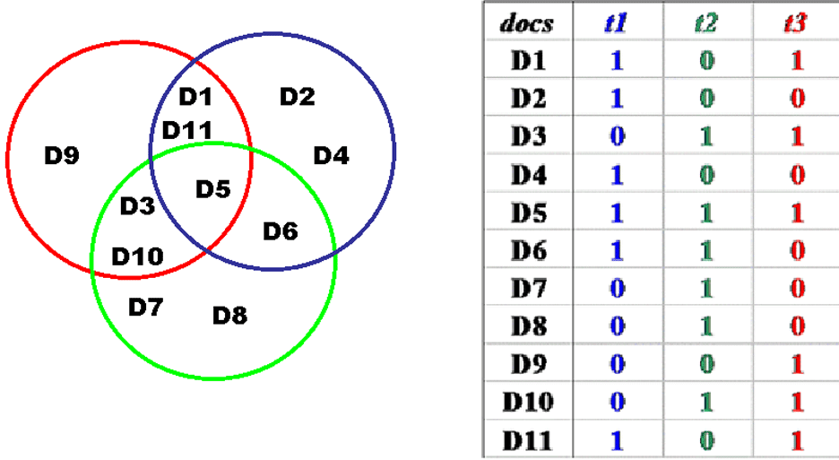
Boolean Document Representation: Terms Present or Absent
50

Slide 51
Relevance in the Boolean Model
Because terms are either present or absent, a document is either relevant or not relevant
But this is clearly flawed -- if a query is "a and b" the Boolean model retrieves only those documents that contain both of them, and treats documents that contain only a or only b as equally irrelevant
THIS IS EQUIVALENT TO SAYING THAT THE BOOLEAN MODEL HAS NO WAY TO REPRESENT TYPICALITY OR GRADED MEMBERSHIP IN A CATEGORY
51

Slide 52
Gradience in Category Membership
Which bird is most typical of the category?
Least typical?
52

Slide 53
Motivating Term Weighting
The Boolean model represents documents as a set of index terms that are either present or absent
This binary notion doesn't fit our intuition that terms differ in how much they suggest what the document is about
We fix this problem by assigning weights to each term in the index
53

Slide 54
The Vector Model of Document Description

Slide 55
Vectors
Vectors are an abstract way to think about a list of numbers
Any point in a vector space can be represented as a list of numbers called "coordinates" which represent values on the "axes" or "basis vectors" of the space
55

Slide 56
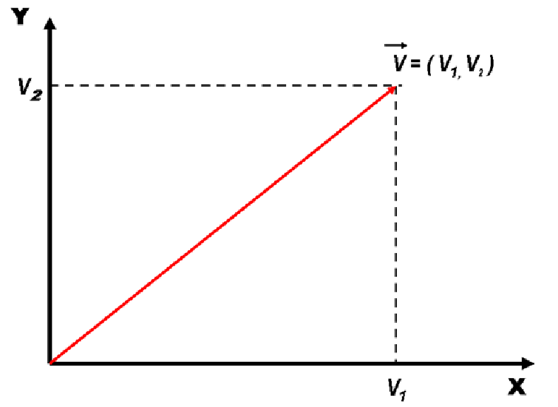
Vectors
56

Slide 57
Document Representation in the Simple Vector Model
Documents and queries are represented in the same way as word or term vectors
Each dimension is the count of occurrences for a term
There is no representation of word order (sentence structure) in the vector - it is still just a BAG OF WORDS
57

Slide 58
Document Similarity in the Vector Model
Vector algebra provides a model for computing similarity between queries and documents and between documents because of assumption that "closeness in space" means "closeness in meaning”
How does this change the relevance measure?
Have we defined “similarity” or are we just hand-waving?
58

Slide 59
Defining Similarity
Some people say that similarity is a meaningless and "mostly vacuous" concept because there must always be some unstated description properties when two things are compared
Once similarity is defined in terms of specific properties and some metric for comparing them, there is nothing for a "similarity" mechanism to do
Defining similarity in some way based on properties is an implementation of which model of category membership?
59

Slide 60
Calculating Similarity in Vector Models
The similarity between a query and a document, or between two documents, is defined as the "inner product" of their vectors
The inner product of two vectors is the sum of the products of their overlapping terms (so similarity increases when they have more terms in common)
v1 = (3, 8, 4) v2 = (2, 3, 1)
(3, 8, 4) x (2, 3, 1) = (3 x 2) + (8 x 3) + (4 x 1) = 34
Other models define similarity differently. Next lecture!
60

Slide 61
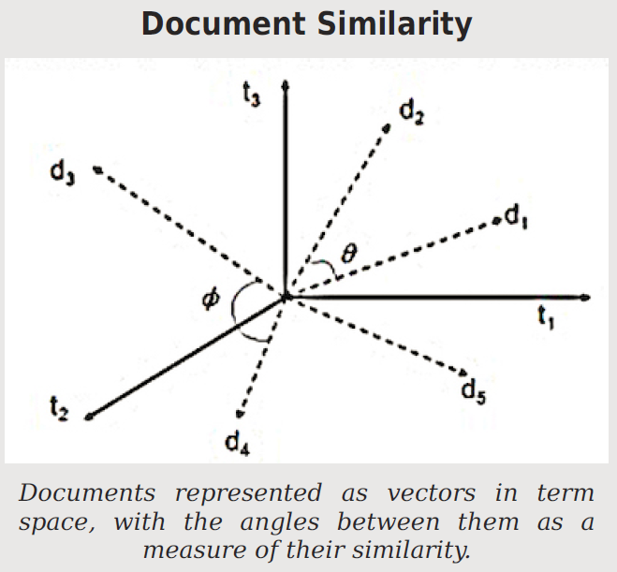
When document vectors are normalized to length 1, the cosine between them is a similarity measure that ranges from 0 to 1
Qualitatively or intuitively, this means that documents are more likely to be about the same topics when they use the same terms in the same proportions

Slide 62
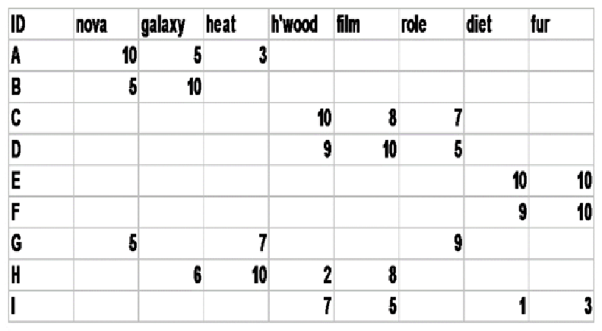
Document x Term Matrix
We can represent for each document the frequency of the words (or terms created by stemming morphologically related words) that it contains
62

Slide 63
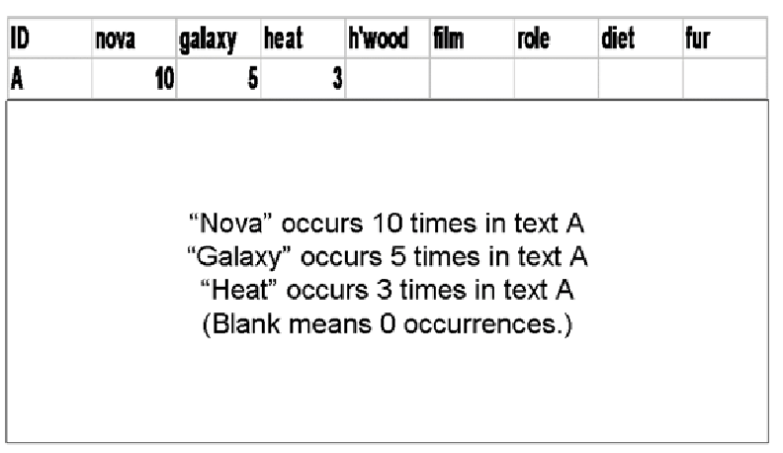
Document Vector
63

Slide 64
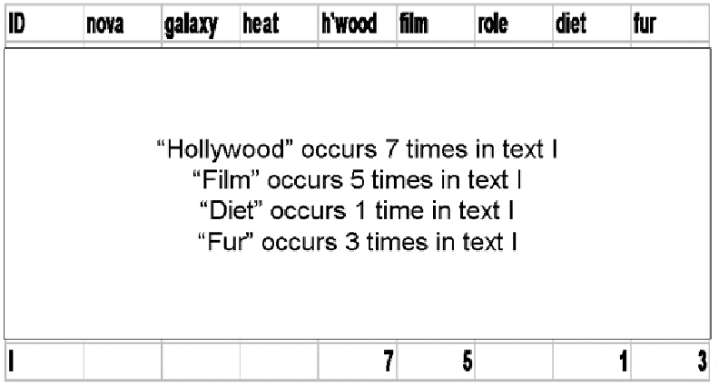
Document Vector
64

Slide 65
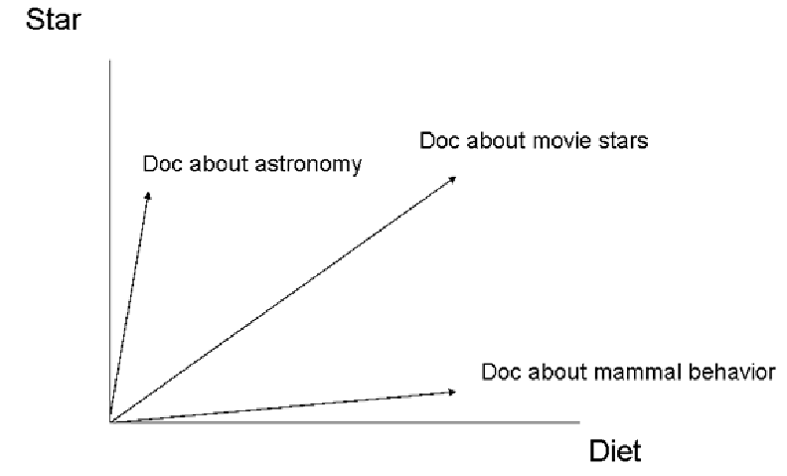
Documents in Term Space – 2D
65

Slide 66
The Vector Model for Representing Words

Slide 67
Word Embeddings
In the last few years, the idea of representing specific documents as vectors was generalized to the idea of representing the meaning of words in a language as vectors
Neural networks can be trained to represent words as points in some abstract “meaning space” in which related words are nearer to each other
“Word2vec” – invented by Google in 2013 – is a popular example of this idea; it uses a vector with 300 coordinates
67

Slide 68
Word2vec Magic
Word2vec and similar word-embedding models are now used in many computational uses of language:
Ranking search results
Translation
Sentiment analysis
If you add or subtract vectors to create a new vector and search for the closest word…
Vietnam + capital = Hanoi
German + airlines = Lufthansa
Doctor – man + woman = nurse (OOPS!)
68

Slide 69
TODAY’S MOST IMPORTANT SLIDES

Slide 70
Comparing Resource Descriptions
All information retrieval systems compare a description of a user’s needs with descriptions of the document resources that might satisfy them
“Relevant documents” are the category to which the search query and retrieved information (document) both belong
Likewise, any “classifier” whose purpose is to determine the category to which a resource belongs must compare the resource description with some description or representation of the category

Slide 71
Categories from Descriptive Statistics (1)
The simplest way to create categories is to compute descriptive statistics and histograms for property values
These reveal if there is any useful or meaningful variation that could be the basis of an organizing principle that distinguishes resources in interactions with them
A lot of data science starts by doing this with a large number of properties at the same time, not just one at a time (“Feature Selection”)

Slide 72
What Words Best Describe a Document? (2)
For any large document collection, it is necessary to pre-process the text of documents to select / create a smaller set of terms that better represent them; in IR these are called the INDEX terms
This selection and processing creates a controlled vocabulary for describing the contents of a document collection
72

Slide 73
Selecting Index Terms
At this stage in text processing the text collection is represented as a set of stems or phrases
But not all of them should be kept; some will retrieve too many, and some too few documents
We can select better index terms if we analyze the frequency distribution of the words in the collection
73

Slide 74
The Boolean Model
The Boolean model represents documents and queries as sets of index terms that are either present or absent
This is a “bag of words” – no sentence structure or languageness remains
Term frequency is not represented in any way; terms are either present or absent
This enables comparisons between queries and document collections using set theory operations with Boolean algebra, making relevance a binary decision
74

Slide 75
Document Representation in the Vector Model
Documents and queries are represented in the same way as word or term vectors
Each dimension is the count of occurrences for a term
There is no representation of word order (sentence structure) in the vector - it is still just a BAG OF WORDS
75

Slide 76
Document Similarity in the Vector Model
Vector algebra provides a model for computing similarity between queries and documents and between documents because of assumption that "closeness in space" means "closeness in meaning”
How does this change the relevance measure?
Have we defined “similarity” or are we just hand-waving?
76

