Slide 1
CogSci 150 “Sensemaking and Organizing” Spring 2022
Robert J. Glushko
glushko@berkeley.edu
26 April 2022
27) Computational Categorization and Classification

Slide 2
Course Endgame
TODAY (4/26): “Computational Classification”
Zoom office hours today from 2-3pm
THURDAY-FRIDAY (4/28-29) 2nd EXAM
TUESDAY 5/3: Case Study Presentations
THURSDAY 5/5: Case Study Presentations
Class party at Jupiter, 6-7pm
FRIDAY 5/6: Last Day for “Free Read” of Case Study Report (you get comments back by 5/7)
TUESDAY 5/10: Case Study Reports Due

Slide 3
Case Study Presentations
TELL A STORY ABOUT YOUR ORGANIZING SYSTEM in 5 minutes
No more than 3 slides; one should be the “artifact” that conveys the biggest ideas and that you’ll spend the most time explaining
If you still need some inspiration, flashback to “Models for Organizing Systems” in 1/25 lecture
You will need to turn in your slides by 10am on the day of your presentation so we can put them into a single file
Don’t mindlessly follow the design questions outline – emphasize the ones that are most important for your organizing system
Be careful - the “how” question is about organizing principles, not the amount of organization (there is some confusion in older case studies)
Sign up for your time slot on 5/3 or 5/5 in the Google Doc in today’s announcement

Slide 4
Today’s Lecture
Computing similarity
Computational classification
How Spotify uses 3 types of classifiers
Sensemaking & Organizing on Machine Learning & Computational Classification

Slide 5
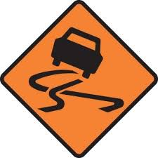
The last two lectures on Computational Description and Computational Classification are an insane attempt to compress a semester of information science and machine learning topics into two lectures
My goal is to help you see how these topics fit into the discipline of organizing, not to fully explain them in much detail (which is why we the 2nd exam will barely touch these topics in qualitative and not quantitative ways)

Slide 6
Computing
Similarity

Slide 7
Defining Similarity
Some people say that similarity is a meaningless and "mostly vacuous" concept because there must always be some unstated description properties when two things are compared
Once similarity is defined in terms of specific properties and some metric for comparing them, there is nothing for a "similarity" mechanism to do
Defining similarity in some way based on properties is an implementation of the qualitative notion of family resemblance
7

Slide 8
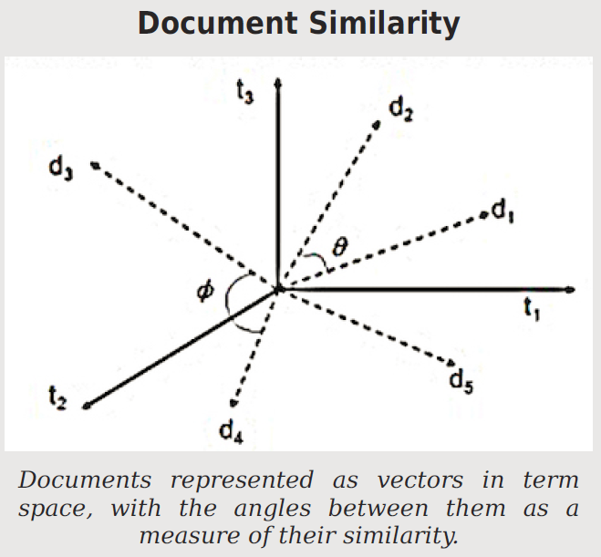
FLASHBACK: The Document Vector Model
When document vectors are normalized to length 1, the cosine between them is a similarity measure that ranges from 0 to 1

Slide 9
Why Google Invented “Page Rank”
How does “search engine bombing work?
A “Donald Trump” query would highly rank a 3-word document “Donald Trump xxxx”
The first web search engines used document vectors and computed similarity/relevance using cosine similarity; this works well in “controlled” document collections
But for short queries, this method highly ranks short documents that contain little more than the query terms… which enabled “search engine bombing”
Google added “page ranking” to its relevance calculations to bias results toward highly-linked web pages
9

Slide 10
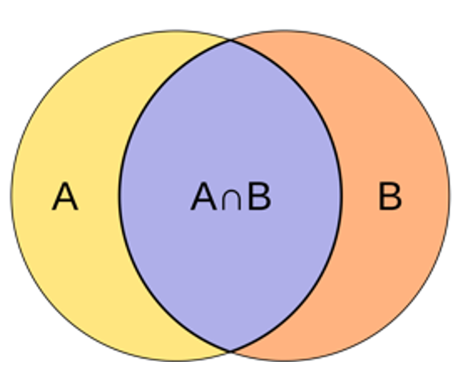
Jaccard Similarity: Proportion of Shared Features
If resources are represented as sets of properties, some might be shared, and others are distinctive and not shared
Since this is a proportion, the values range from 0 (no shared features) to 1 (all features are shared)

Slide 11
Jaccard Similarity
Jaccard is the simplest property-based similarity measure
It makes the most sense when features are binary, either present or absent
Jaccard can be used with document vector models if terms aren’t weighted by frequency

Slide 12
STOP AND THINK: HOW SIMILAR ARE A AND B?
CASE 1
Object A
CASE 2
Object A
P1
P2
P9
P4
P2
P3
P5
P1
P3
P4
P7
P6
P11
P5
P6
P8
P10
P7
P12
P13
Object B
Object B

Slide 13
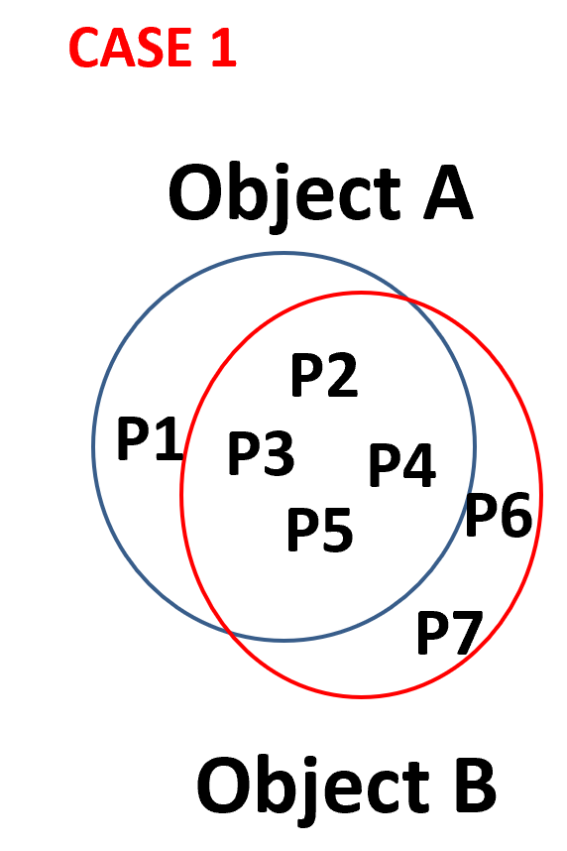
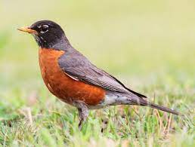
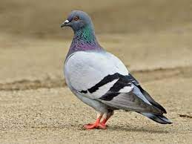
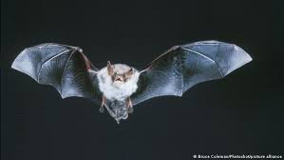
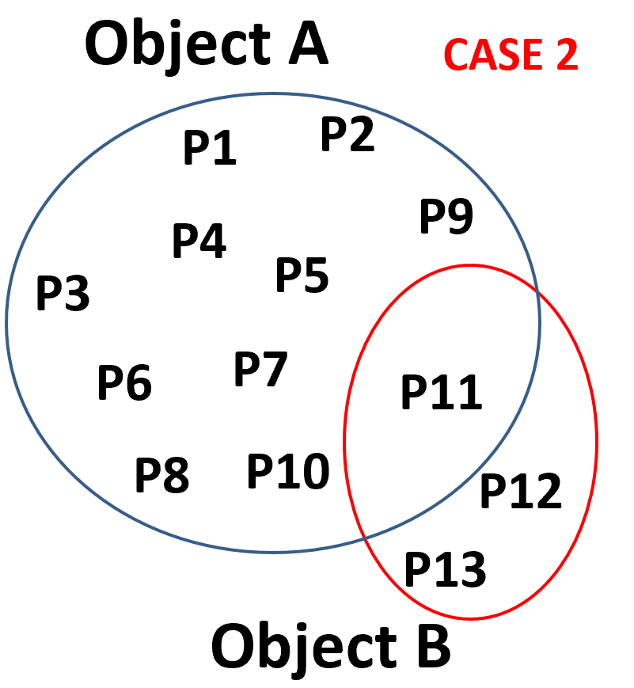
Jaccard Similarity Example
Case 1: A is a robin, B is a pigeon, very similar birds, share the characteristic bird features with just a few small differences; similarity is high: 4/7
Case 2: A is a robin; B is a bat – share the flying feature but nothing else; similarity is low (1/13)
They have few shared features, so the similarity calculation is dominated by their distinctive features

Slide 14
A “Jaccard-like” Heuristic for Designing “Semantically Balanced” Categories
In a good system of categories, the categories at the same hierarchical level (co-hyponyms) have the same degree of abstraction or breadth
A heuristic for doing this is to ensure that the pairwise similarity is about the same for all category pairs
Musical Instruments
Woodwinds
Violins
Cellos
Musical Instruments
Woodwinds
Strings
Violins and cellos are much more similar to each other than they are to woodwinds
14

Slide 15
STOP AND THINK: Is Similarity a Symmetric Relationship?
The Jaccard measure uses a very simple concept of similarity and assumes that it is a symmetric relationship
Does “A is similar to B” (or “A is like B”) mean the same thing as “B is similar to A” (or “B is like A”)?
15

Slide 16
Similarity Can be Asymmetric
When we compare an A with a B with a statement about similarity, we often order A and B to make the more salient or “feature complex” one as the referent
“the portrait resembles the father” NOT “The father resembles the portrait”
The more salient resource is judged less similar to the less salient one than vice versa
North Korea is judged more similar to China than China is judged similar to North Korea
Can Jaccard similarity handle asymmetry ?
16

Slide 17
Tversky’s Contrast Model (1)
Tversky proposed a more general measure of similarity that considers both shared and distinctive features
The more features shared by A and B, the more similar they are
The more features that one has that the other lacks, the less similar
17

Slide 18
Tversky’s Contrast Model (2)
Each of these three sets of featured can be weighted differently, unlike Jaccard where they are equally weighted – so Jaccard can’t handle asymmetry
This model explains why similarity judgments are not always symmetric
18

Slide 19
Tversky Asymmetric Similarity
A description of China requires more properties than a description of North Korea
The two countries have a small number of properties in common
Because the distinctive features of China are more important than those of North Korea, their greater weighting reduces the similarity when China is compared to NK rather than vice versa

Slide 20
Geometric or Distance Models of Similarity
If the property values are metric, a resource can be represented as a point in N-dimensional space, with property values as the coordinates
We can measure the differences between the values on each shared property separately
Similarity is inversely related to distance computed as
The most common distance model is the Euclidean one. What exponent does it use? What happens if we use other exponents?
20

Slide 21
What is the exponent in the city block distance function?
Do you see how this simply adds the distances on each dimension?

Slide 22
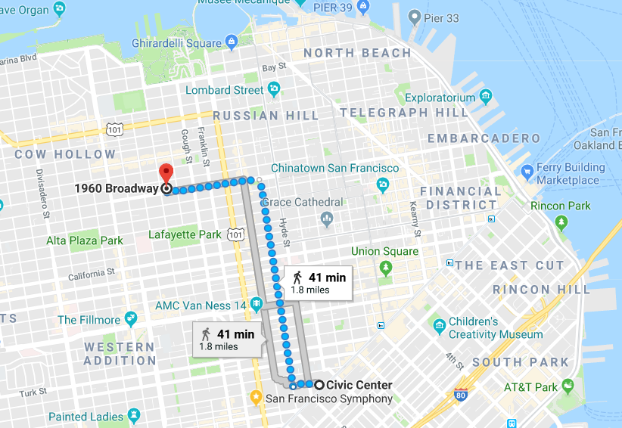
“City Block” Distance Measurement
(there is no hypotenuse path)

Slide 23
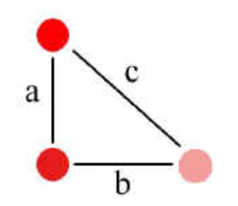
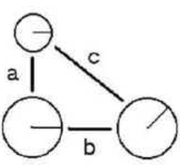
Fused vs. Separable Properties –> Integrated vs. Additive Comparisons
Properties of color and saturation are fused, and Euclidean metrics better fit similarity judgments
Circle size and radius angle are separable properties, and City Block metric better fits similarity judgments

Slide 24
Infinite Exponents
The Chebyshev function defines the distance between two items as the difference of their values on the single property with the greatest difference (this treats the exponent as infinite)
Two items could have similar or even identical values on most properties, but if they differ much on just one property, they will be treated as very dissimilar
People often use this function… or something like it… in their social behavior
How can we analogize this function to stereotyping or other prejudicial comparisons?

Slide 25
Zero Exponents
At the other extreme, if the exponent is reduced to zero, this treats each proper­ty as binary, either present or absent, and the distance function becomes a count of the number of times that the value of the property for one item is dif­ferent from the value for the other one
This is called the “Hamming distance”

Slide 26
Transformational Models of Similarity (1)
Transformational models assume that the similarity between two things is inver­sely proportional to the complexity of the transformation required to turn one into the other
The simplest transformational model of similarity counts the number of properties that would need to change their values
26

Slide 27
Transformational Models of Similarity (2)
The “edit distance” between two strings is the number of insertion, deletion, and sub­stitution operations needed
Transform Book -> Bob (distance = 2)
1) delete “o”
2) substitute “b” for “k”
Two strings with a short edit distance might be variant spellings or mis­spellings of the same name, and transformational models that are sensitive to common typing errors like transposed or duplicated letters are very effective at spelling correction
27

Slide 28
Structure Models
Geometric and Feature models don’t work well when comparing things that have lots of internal hierarchical or relational structure
In these cases, comparing matching features is insufficient; you need to compare features with similar roles in structures or relationships
Similarity is like analogy
In analogies, relationships are shared
In similarity, both relationships and features are shared
28

Slide 29
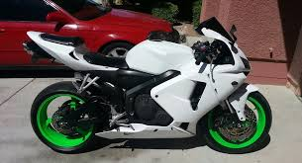
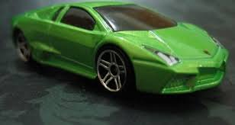
Common Feature But Low Similarity
These two things share the feature “green,” but this matching feature does not increase their similarity much because the motorcycle’s wheels do not correspond to the car body

Slide 30
Structure Models are Asymmetric
Structural comparisons can often be made in both directions
Each direction implies a different meaning
“A man is like a tree” -> a man has roots
“A tree is like a man” -> a tree has a life history
30

Slide 31
Computational Classification

Slide 32
Distinguishing Categorization and Classification
FLASHBACK
Categories are EQUIVALENCE CLASSES - sets of resources, processes, and events that we treat the same
A Classification (noun) (or Classification Scheme) is a SYSTEM OF CATEGORIES, ordered according to a PRE-DETERMINED SET OF PRINCIPLES and used to organize a collection of resources
Classification (verb) is the process of systematically assigning resources to categories in a classification system
32

Slide 33
Why Computational Classification?
Some classification tasks are hard because the categories are “close together” and the resource properties or features involved are not easy to understand and use
Some classification tasks are inherently difficult:
they require feature selection or extraction from a very large candidate set
the algorithms by which the classier learns and uses the features are complex
Sometimes simple classification tasks can't be done by people at the needed scale or speed

Slide 34
Classifiers
A COMPUTER SCIENCE DEFINITION:
A classifier is a system whose input is a vector of discrete or continuous feature (or attribute) values and whose output is the name of the class
This vector might be the description of a document, an image, a person, a molecule, just about anything
If the “Classifier” is a person determining what type of thing something is, does this definition still fit?
34

Slide 35
Classifiers - Examples
Classifiers for text identify its language, topic, author, sentiment, or other characteristics
Recommendation systems identify “matching” resources in different categories
If two people tend to agree on their movie ratings, then if one of them likes a new movie, you can recommend it to the other
Classifiers can identify categories of people who are likely or not likely to do something (“behavior prediction”)
35

Slide 36
Classifying Classification Tasks
Binary classification – example: spam or not?
Multi-class
1 of M – where does this resource fit into some set of categories
Example: in which existing Amazon or Spotify category does this belong?
N of M – what topic or keyword from some controlled vocabulary do we apply to this resource? We can consider this as multiple binary classifications (does this topic fit or not?)

Slide 37
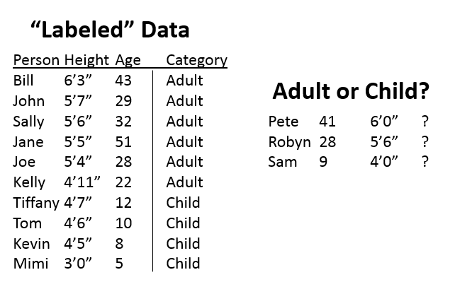
A Simple 2-Category Classification Problem
Here we have some “labeled data”-- a dataset with 2 features for each person being classified and the category each belongs to.
We then are given 3 new people with their feature values and our task it the classify them as adult or child.
Why is this a “simple”
classification problem?

Slide 38
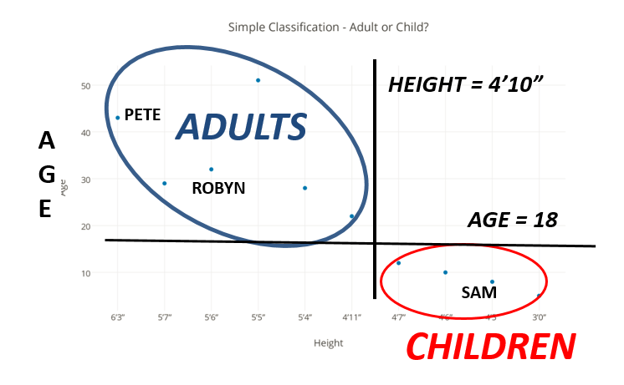
Why This Is a “Simple” Classification: You Don’t Need Labeled Data or Computation to Distinguish the Categories
Some classification tasks are simple because the categories are “far apart” (or “carved at the joints”) and the resource properties are easy to understand

Slide 39
Creating a Classifier
A (machine) learner takes a set of pairs of inputs and outputs and devises a mapping between them
If the outputs are “labeled” or categorized already, this is SUPERVISED learning
If the learner has to discover the mapping by detecting the “interesting patterns” in the data, this is UNSUPERVISED learning (also called “statistical pattern recognition”)
Most human learning is unsupervised; even when labels are provided, they rarely cover more than a fraction of the possible examples of the category
The goal of every classifier is to be able to generalize beyond the examples used to train the classifier

Slide 40
The Classification Process
Train and test
after you've chosen features and an algorithm, you let it "learn" - adjusting the weights it gives to each feature....
Classify new examples
Analyze the results
Modify the training data, adjust the learning algorithm, and train again

Slide 41
Three Parts in Every Classifier
Representation
the formal language used by the classifier: what kind of model can the learner learn?
Evaluation
the “objective” or scoring” function: how good is the classifier?
Optimization
how does the learning algorithm search for a better solution?

Slide 42
ML approaches / models
These differ “in how they learn” and in “what they learn” – different assumptions about the domain, how clear the boundaries are between categories
LOGICAL – category membership can be determined using understandable rules about feature values
Decision trees
GEOMETRIC – resources are represented in a multidimensional feature space and concepts like distances, lines, and planes are used to create the boundaries between categories
Nearest-neighbors, Support vector machines
PROBABILISTIC – features have probabilities; goal is to estimate the probability of category membership from the probability distributions for the features
Naïve Bayes (called “naïve” because it makes the assumption that features are independent, even though they aren’t)
This taxonomy comes from Flach (2012), Machine Learning

Slide 43
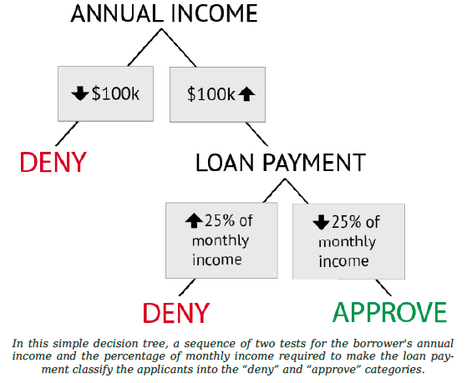
Simplest Computational Classifier:
Rule-Based Decision Tree
TDO Figure 7.1
How is this decision tree using the concepts of classical categories?

Slide 44
Simplest Computational Classifier:
Rule-Based Decision Tree
TDO Figure 7.1
Should you give this person a loan?
We describe each person with two features, annual income and the amount of the loan payment they would have as a percentage of their income.
We test these feature values in succession, so there’s a hierarchy of binary classifiers.
Only people who pass both tests are members of the “approve” category and can get a loan

Slide 45
Unsupervised Learning: Clustering
Clustering is an unsupervised learning method to automatically group related content or resources by discovering the correlations between features or properties of the things to be classified (usually via computations that maximize similarity within categories and minimize it between them)
Items are represented as a vector of property values or probabilities of property values, which enables similarity to be calculated using some kind of distance function
Similarity is iteratively recalculated each time an item is added to a cluster

Slide 46
Clustering Search Results
Search result clustering can be quite effective when users enter generic or ambiguous terms (such as apple) or when the dataset contains a disparate set of categories
Labels take on more significance, since users will likely treat them like facets to make decisions about how to further navigate the result set

Slide 47
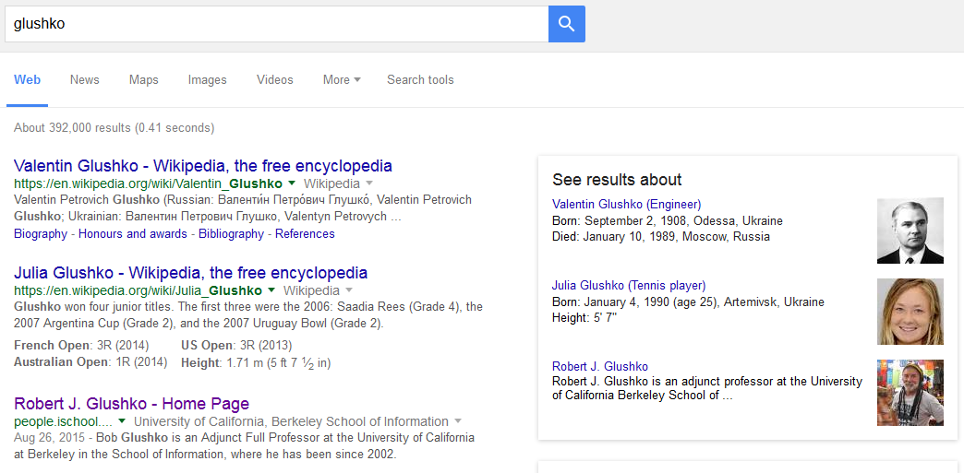
Categorized Search Results

Slide 48
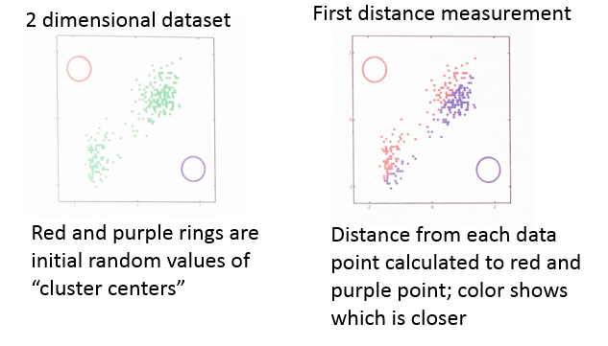
K-Means Clustering Example
From Murphy, “Machine Learning”, p 353
(The most popular unsupervised learning algorithm, uses iterative similarity recalculation)

Slide 49
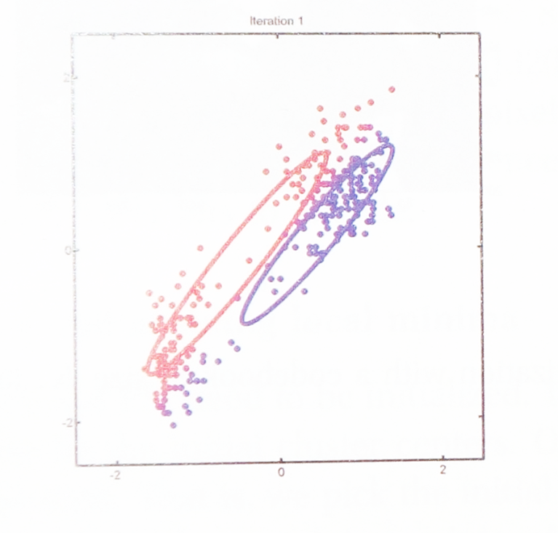
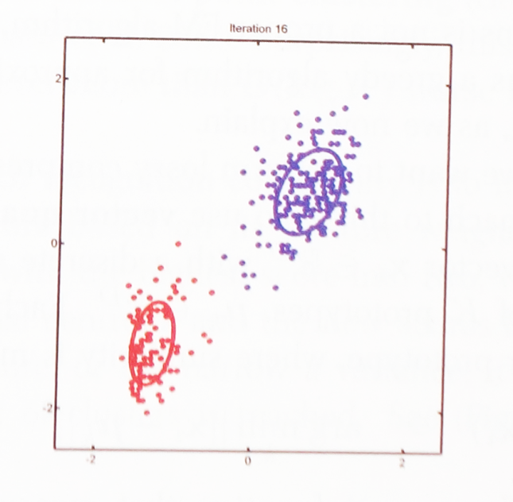
Clustering Example
From Murphy, “Machine Learning”, p 353
First recalculation
After 16 recalculations
Average of points assigned to each color becomes new value of parameter
The parameters have converged to clearly identify the centers of the red and purple clusters

Slide 50
If you like to study algorithms… otherwise just skip this slide

Slide 51
STOP AND THINK: How do you find the value of k that fits the data best?
In the previous example I slipped something by you, which is that I just assumed there were two clusters, because that’s what the data plot seemed to be showing. Many clustering algorithms find as many clusters as you tell it to look for (that’s the k).
So it is important to look carefully at the data!

Slide 52
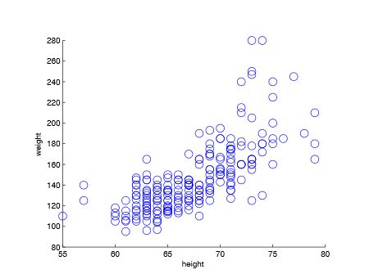
How Many Categories Here?
Height and weight dataset

Slide 53
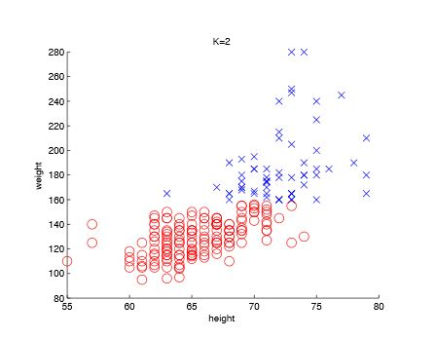
K=2
We know our sample contains Men and Women
Try K=2 and see if that creates useful categories

Slide 54
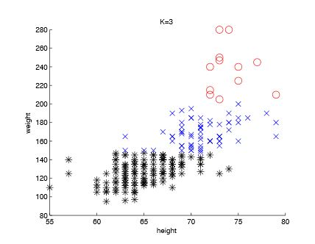
K=3
But if we know that we have women, men who are not basketball players, and men who are basketball players in the sample, try k=3

Slide 55
Another commonly used clustering algorithm is called hierarchical clustering – it creates a tree structure of categories that are progressively more abstract – doesn’t label them

Slide 56
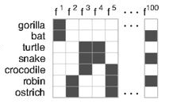
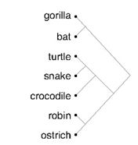
Hierarchical Clustering Example
Charles Kemp, and Joshua B. Tenenbaum PNAS, “The Discovery of Structural Form” 2008;105:10687-10692
Start with each item in its own cluster, merge the two most similar clusters, recalculate similarity between clusters, do it again… Builds a tree from the bottom up.

Slide 57
After We’ve Clustered, We Classify
Algorithms that create clusters or categories of similar items can be later used as classifiers by using the same similarity measures to compare the unclassified items against items that are labeled by category
Different approaches:
Compare against prototypes of each category, an average of all the properties of all the category members
Compare against examples that are close to the center of each category (“nearest neighbors”)
Compare against the examples that are near category boundaries (“support vectors”)

Slide 58
How Spotify Uses Three Types of Classifiers

Slide 59
Spotify Case Study
Every Monday, over 200 million users open Spotify to find 30 new songs waiting in a personalized playlist called Discover Weekly, tailored specifically to their listening habits
This recommendation system uses three types of data
Collaborative filtering
Natural language processing
Audio analysis

Slide 60
Collaborative Filtering
What songs has a user listened to or added to a playlist?
Which other users have a similar user/song vector? (people with similar tastes in music)
What songs have the “similar users” listened to that the target user hasn’t heard?

Slide 61
Natural Language Processing
How are artists and songs described in news stories, blogs, social media, and other information sources?
Key words and phrases are analyzed by sentiment to create “cultural vectors” for each artist and song
Vector similarity calculations identify artists and songs that should have similar affect for users

Slide 62
Audio Analysis
Instead of relying on interaction traces between people and music, this technique analyzes the sound recording
Low-level statistics about frequency spectrum and amplitude are complemented by higher-order categorizations based on harmony, chords, and more stylistic properties
Songs similar to those in a user’s listening history are recommended

Slide 63
Sensemaking & Organizing on Machine Learning & Computational Classification

Slide 64
The S & O Perspective on the Supervised Learning process
Specify classes (categories)
How many classes should there be? What biases does the system embody? What is the “warrant” for the classes?
Label examples
Are the examples representative? How are they selected? A larger training set might discover more classes.
Who does the labeling? Can you find enough experts to label a large enough training set? Is the labeling process reliable?
Extract features / Choose a classifier algorithm
How are the features that are identified influenced by the system of classes? More classes means that more features will be needed, but they might be less interpretable

Slide 65
The S & O Perspective on the Machine Learning product
One important way in which ML approaches differ is the extent to how the classifier works can be interpreted in by people
For some classification problems it might not matter (e.g., predicting the weather), but for others interpretability could be required by law, by common sense, or by ethical guidelines
Many supervised learning techniques are not interesting from a S&O perspective because they just trying to do what people do at greater speed and scale and don’t provide new insight
On the other hand, unsupervised learning programs that try to discover categories can provide new insights
Likewise, approaches that reduce the dimensionality of resource description can provide insight

