Slide 1
CS294-129: Designing, Visualizing and Understanding Deep Neural Networks
John Canny
Fall 2016
Lecture 14: Attention Models

Slide 2
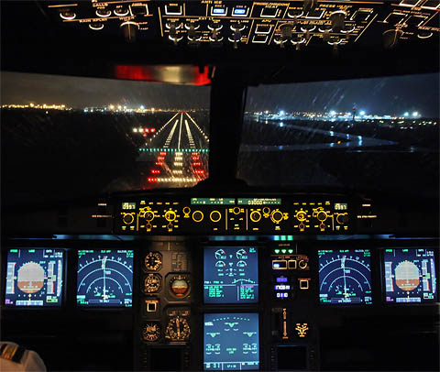

Slide 3
Early attention models
Larochelle and Hinton, 2010, “Learning to combine foveal glimpses with a third-order Boltzmann machine”
Misha Denil et al, 2011, “Learning where to Attend with Deep Architectures for Image Tracking”

Slide 4
2014: Neural Translation Breakthroughs
Devlin et al, ACL’2014
Cho et al EMNLP’2014
Bahdanau, Cho & Bengio, arXiv sept. 2014
Jean, Cho, Memisevic & Bengio, arXiv dec. 2014
Sutskever et al NIPS’2014

Slide 5
Other Applications
Ba et al 2014, Visual attention for recognition
Mnih et al 2014, Visual attention for recognition
Chorowski et al, 2014, Speech recognition
Graves et al 2014, Neural Turing machines
Yao et al 2015, Video description generation
Vinyals et al, 2015, Conversational Agents
Xu et al 2015, Image caption generation
Xu et al 2015, Visual Question Answering

Slide 6
Soft vs Hard Attention Models
Hard attention:
Attend to a single input location.
Can’t use gradient descent.
Need reinforcement learning.
Soft attention:
Compute a weighted combination (attention) over some inputs using an attention network.
Can use backpropagation to train end-to-end.

Slide 7
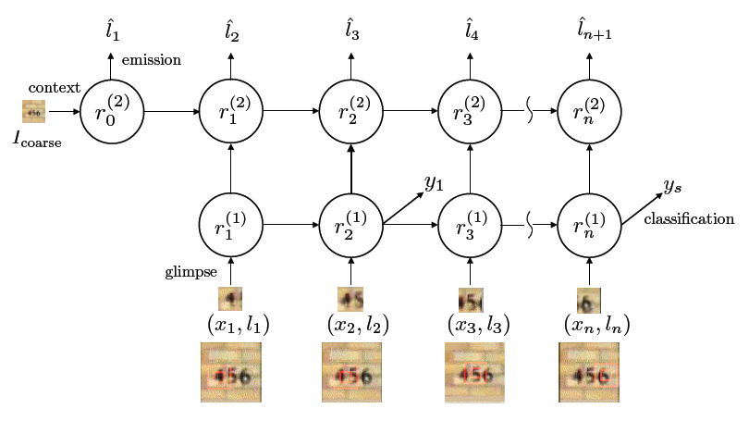
Attention for Recognition (Ba et al 2014)
RNN-based model.
Hard attention.
Required reinforcement learning.
l_{i} = location
x_{i} = image

Slide 8
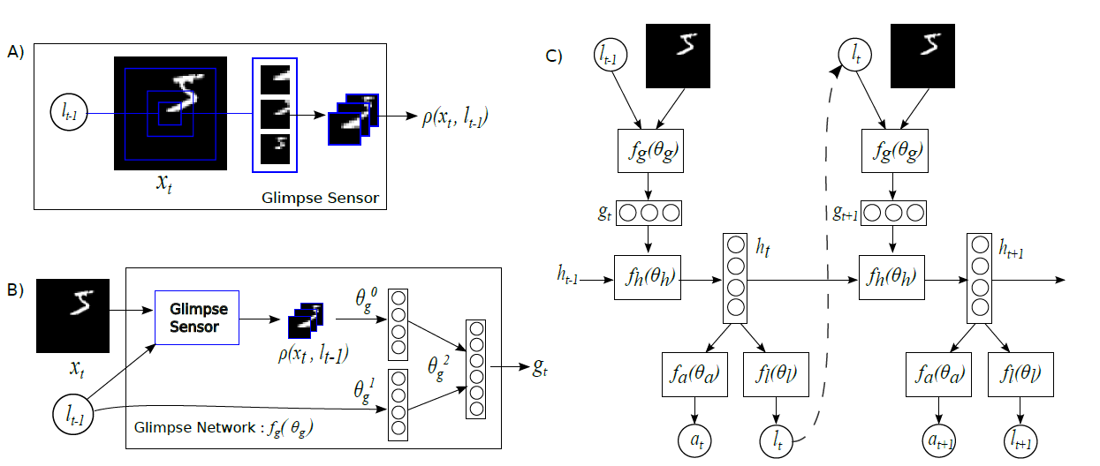
Attention for Recognition (Mnih et al 2014)
Glimpses are retinal (graded resolution) images
l_{i} = location
a_{i} = action (classification)

Slide 9
Attention for Recognition (Mnih et al 2014)
Glimpse trace on some digit images:
Green line shows trajectory, other images are the glimpses themselves.

Slide 10
Soft Attention for Translation
“I love coffee” -> “Me gusta el café”
Bahdanau et al, “Neural Machine Translation by Jointly Learning to Align and Translate”, ICLR 2015

Slide 11
Soft Attention for Translation
Distribution over input words
“I love coffee” -> “Me gusta el café”
Bahdanau et al, “Neural Machine Translation by Jointly Learning to Align and Translate”, ICLR 2015

Slide 12
Soft Attention for Translation
Distribution over input words
“I love coffee” -> “Me gusta el café”
Bahdanau et al, “Neural Machine Translation by Jointly Learning to Align and Translate”, ICLR 2015

Slide 13
Soft Attention for Translation
Distribution over input words
“I love coffee” -> “Me gusta el café”
Bahdanau et al, “Neural Machine Translation by Jointly Learning to Align and Translate”, ICLR 2015

Slide 14
Soft Attention for Translation
Distribution over input words
“I love coffee” -> “Me gusta el café”
Bahdanau et al, “Neural Machine Translation by Jointly Learning to Align and Translate”, ICLR 2015

Slide 15
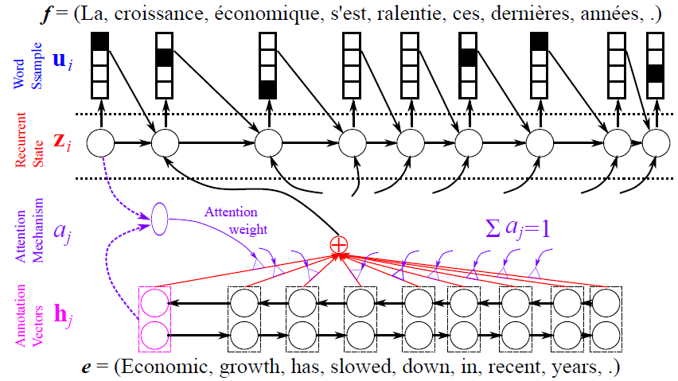
Soft Attention for Translation
From Y. Bengio CVPR 2015 Tutorial

Slide 16
Soft Attention for Translation
Decoder RNN
From Y. Bengio CVPR 2015 Tutorial

Slide 17
Soft Attention for Translation
Decoder RNN
Bidirectional encoder RNN
From Y. Bengio CVPR 2015 Tutorial

Slide 18
Soft Attention for Translation
Decoder RNN
Attention Model
Bidirectional encoder RNN
From Y. Bengio CVPR 2015 Tutorial

Slide 19
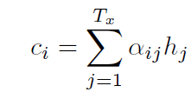
Soft Attention for Translation
Context vector (input to decoder):
Mixture weights:
Alignment score (how well do input words near j match output words at position i):
Bahdanau et al, “Neural Machine Translation by Jointly Learning to Align and Translate”, ICLR 2015

Slide 20
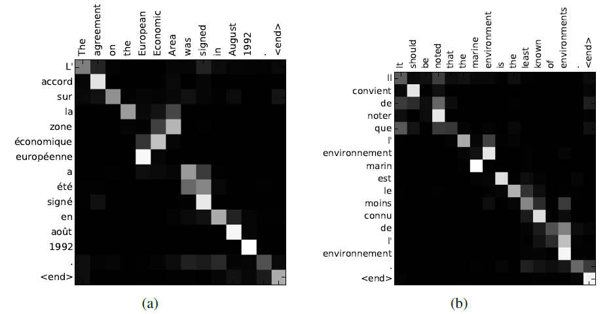
Soft Attention for Translation
Bahdanau et al, “Neural Machine Translation by Jointly Learning to Align and Translate”, ICLR 2015

Slide 21
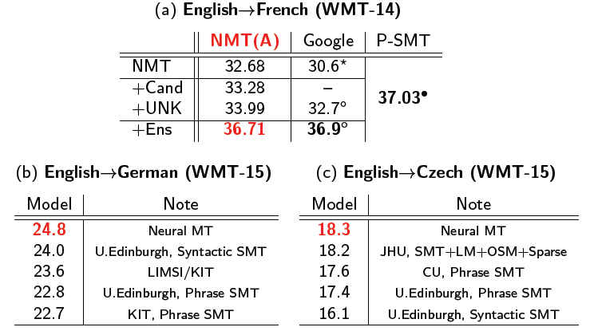
Soft Attention for Translation
Reached State of the art in one year:
Yoshua Bengio, NIPS RAM workshop 2015

Slide 22
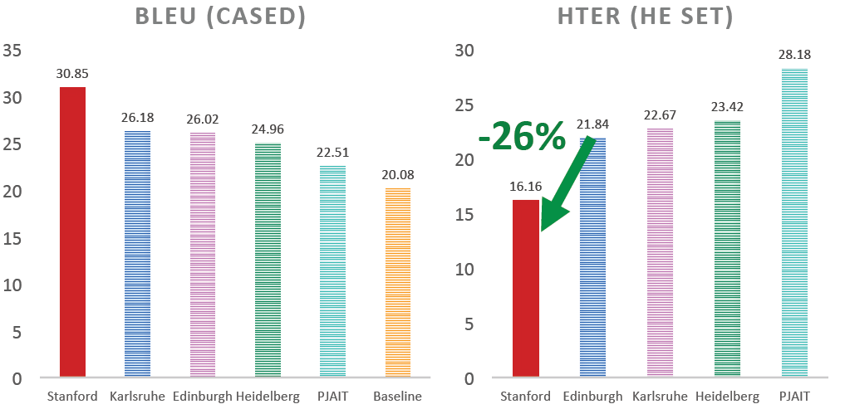
Soft Attention for Translation
Luong, Pham and Manning’s Translation System (2015):
Translation Error Rate vs Human
Luong and Manning IWSLT 2015

Slide 23
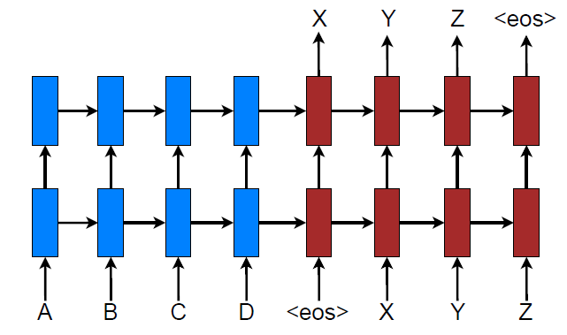
Luong, Pham and Manning 2015
Stacked LSTM (c.f. bidirectional flat encoder in Bahdanau et al):
Effective Approaches to Attention-based Neural Machine Translation
Minh-Thang Luong, Hieu Pham, Christopher D. Manning, EMNLP 15

Slide 24
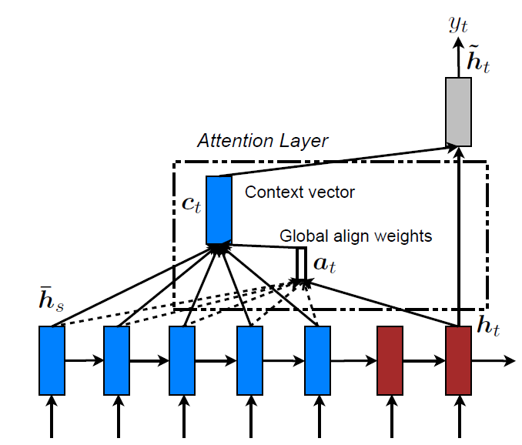
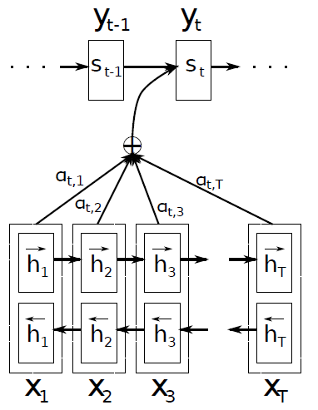
Global Attention Model
Global attention model is similar but simpler than Badanau’s:
Different word matching functions were used
Effective Approaches to Attention-based Neural Machine Translation
Minh-Thang Luong Hieu Pham Christopher D. Manning, EMNLP 15

Slide 25
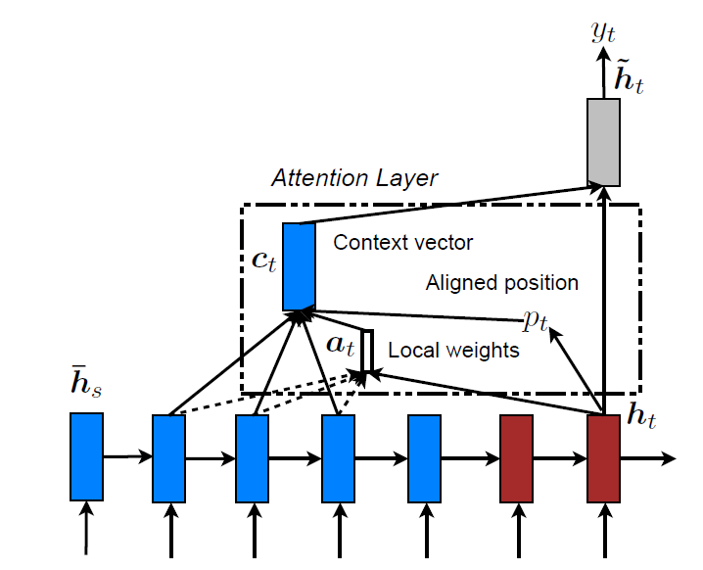
Local Attention Model
Compute a best aligned position p_{t} first
Then compute a context vector centered at that position
Effective Approaches to Attention-based Neural Machine Translation
Minh-Thang Luong Hieu Pham Christopher D. Manning, EMNLP 15

Slide 26
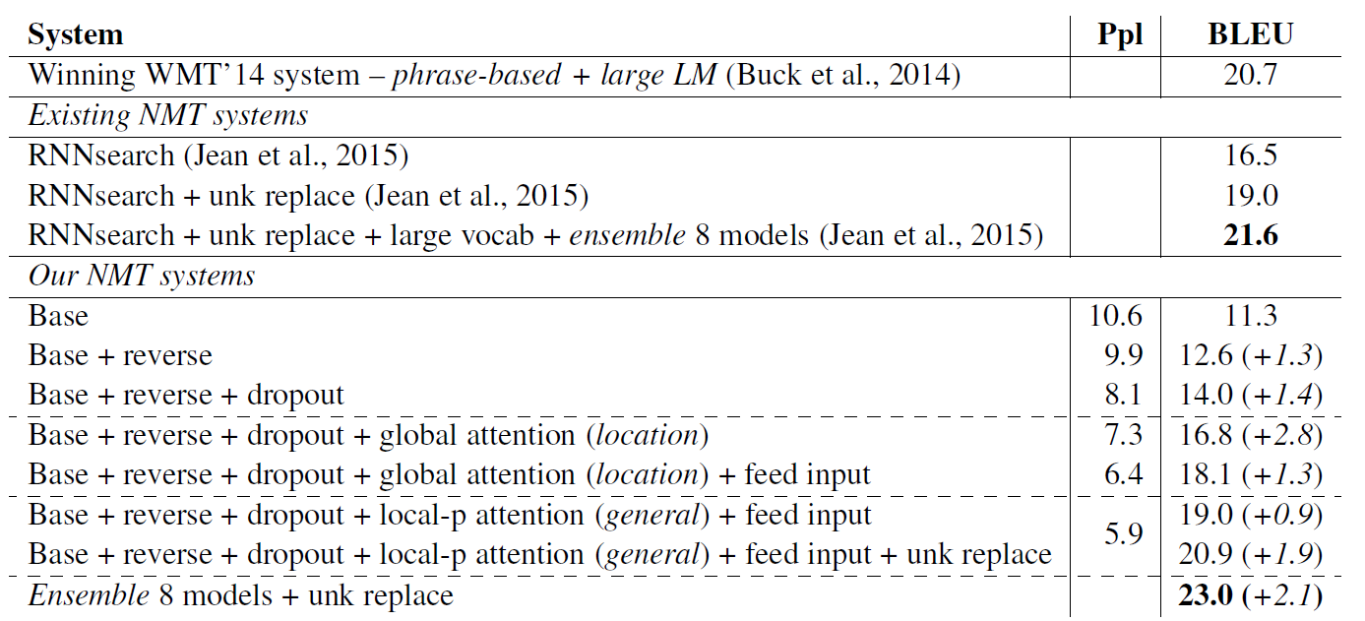
Results
Local and global models
Effective Approaches to Attention-based Neural Machine Translation
Minh-Thang Luong Hieu Pham Christopher D. Manning, EMNLP 15

Slide 27
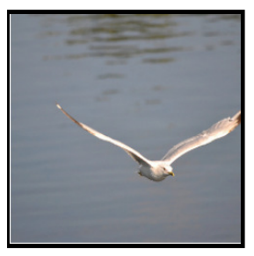
Recall: RNN for Captioning
Image: H x W x 3

Slide 28
Recall: RNN for Captioning
CNN
Image: H x W x 3
Features: D

Slide 29
Recall: RNN for Captioning
CNN
h0
Image: H x W x 3
Features: D
Hidden state: H

Slide 30
Recall: RNN for Captioning
Distribution over vocab
d1
CNN
h0
h1
Image: H x W x 3
Features: D
Hidden state: H
y1
First word

Slide 31
Recall: RNN for Captioning
Distribution over vocab
d1
d2
CNN
h0
h1
h2
Image: H x W x 3
Features: D
Hidden state: H
y1
y2
First word
Second word

Slide 32
Recall: RNN for Captioning
RNN only looks at whole image, once
Distribution over vocab
d1
d2
CNN
h0
h1
h2
Image: H x W x 3
Features: D
Hidden state: H
y1
y2
First word
Second word

Slide 33
Recall: RNN for Captioning
RNN only looks at whole image, once
Distribution over vocab
d1
d2
CNN
h0
h1
h2
Image: H x W x 3
Features: D
Hidden state: H
What if the RNN looks at different parts of the image at each timestep?
y1
y2
First word
Second word

Slide 34
Soft Attention for Captioning
CNN
Features: L x D
Image: H x W x 3
Xu et al, “Show, Attend and Tell: Neural Image Caption Generation with Visual Attention”, ICML 2015

Slide 35
Soft Attention for Captioning
CNN
h0
Features: L x D
Image: H x W x 3
Xu et al, “Show, Attend and Tell: Neural Image Caption Generation with Visual Attention”, ICML 2015

Slide 36
Soft Attention for Captioning
Distribution over L locations
a1
CNN
h0
Features: L x D
Image: H x W x 3
Xu et al, “Show, Attend and Tell: Neural Image Caption Generation with Visual Attention”, ICML 2015

Slide 37
Soft Attention for Captioning
Distribution over L locations
a1
CNN
h0
Features: L x D
Image: H x W x 3
Weighted features: D
z1
Weighted combination of features

Slide 38
Soft Attention for Captioning
Distribution over L locations
a1
CNN
h0
h1
Features: L x D
Image: H x W x 3
Weighted features: D
z1
y1
Weighted combination of features
First word

Slide 39
Soft Attention for Captioning
Distribution over L locations
Distribution over vocab
a1
a2
d1
CNN
h0
h1
Features: L x D
Image: H x W x 3
Weighted features: D
z1
y1
Weighted combination of features
First word

Slide 40
Soft Attention for Captioning
Distribution over L locations
Distribution over vocab
a1
a2
d1
CNN
h0
h1
Features: L x D
Image: H x W x 3
Weighted features: D
z1
y1
z2
Weighted combination of features
First word

Slide 41
Soft Attention for Captioning
Distribution over L locations
Distribution over vocab
a1
a2
d1
CNN
h0
h1
h2
Features: L x D
Image: H x W x 3
Weighted features: D
z1
y1
z2
y2
Weighted combination of features
First word

Slide 42
Soft Attention for Captioning
Distribution over L locations
Distribution over vocab
a1
a2
d1
a3
d2
CNN
h0
h1
h2
Features: L x D
Image: H x W x 3
Weighted features: D
z1
y1
z2
y2
Weighted combination of features
First word

Slide 43
Soft vs Hard Attention
a | b
c | d
CNN
Grid of features
(Each D-dimensional)
Image: H x W x 3
p_{a} | p_{b}
p_{c} | p_{d}
From RNN:
Xu et al, “Show, Attend and Tell: Neural Image Caption Generation with Visual Attention”, ICML 2015
Distribution over grid locations p_{a} + p_{b} + p_{c} + p_{c} = 1

Slide 44
Soft vs Hard Attention
a | b
c | d
CNN
Grid of features
(Each D-dimensional)
Image: H x W x 3
Context vector z (D-dimensional)
p_{a} | p_{b}
p_{c} | p_{d}
From RNN:
Xu et al, “Show, Attend and Tell: Neural Image Caption Generation with Visual Attention”, ICML 2015
Distribution over grid locations p_{a} + p_{b} + p_{c} + p_{c} = 1

Slide 45
Soft vs Hard Attention
Soft attention:
Summarize ALL locations z = p_{a}a+ p_{b}b + p_{c}c + p_{d}d
Derivative dz/dp is nice!
Train with gradient descent
a | b
c | d
CNN
Grid of features
(Each D-dimensional)
Image: H x W x 3
Context vector z (D-dimensional)
p_{a} | p_{b}
p_{c} | p_{d}
From RNN:
Xu et al, “Show, Attend and Tell: Neural Image Caption Generation with Visual Attention”, ICML 2015
Distribution over grid locations p_{a} + p_{b} + p_{c} + p_{c} = 1

Slide 46
Soft vs Hard Attention
Soft attention:
Summarize ALL locations z = p_{a}a+ p_{b}b + p_{c}c + p_{d}d
Derivative dz/dp is nice!
Train with gradient descent
a | b
c | d
CNN
Grid of features
(Each D-dimensional)
Image: H x W x 3
Context vector z (D-dimensional)
Hard attention: Sample ONE location according to p, z = that vector
With argmax, dz/dp is zero almost everywhere … Can’t use gradient descent; need reinforcement learning
p_{a} | p_{b}
p_{c} | p_{d}
From RNN:
Xu et al, “Show, Attend and Tell: Neural Image Caption Generation with Visual Attention”, ICML 2015
Distribution over grid locations p_{a} + p_{b} + p_{c} + p_{c} = 1

Slide 47
Soft Attention for Captioning
Soft attention
Hard attention

Slide 48
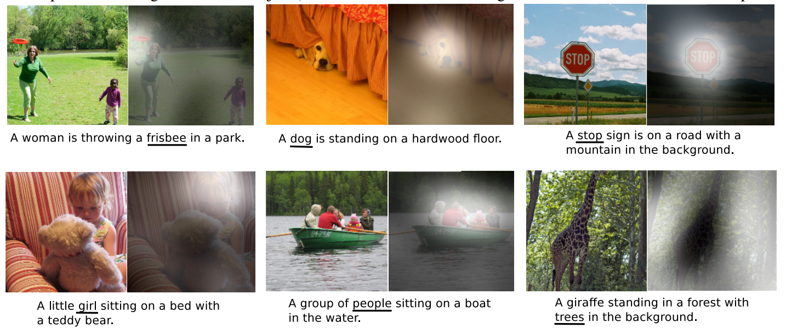
Soft Attention for Captioning

Slide 49
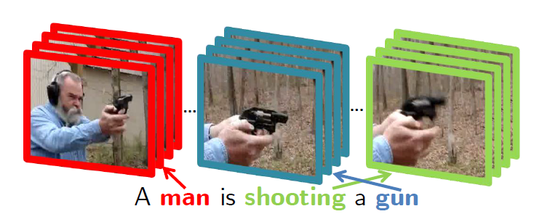
Soft Attention for Video
“Describing Videos by Exploiting Temporal Structure,” Li Yao et al, arXiv 2015.

Slide 50
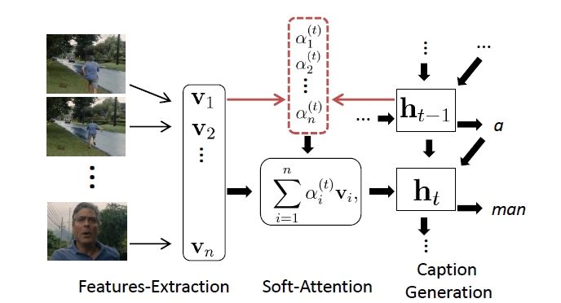
Soft Attention for Video
The attention model:
“Describing Videos by Exploiting Temporal Structure,” Li Yao et al, arXiv 2015.

Slide 51
Soft Attention for Video
“Describing Videos by Exploiting Temporal Structure,” Li Yao et al, arXiv 2015.

Slide 52
Soft Attention for Captioning
Attention constrained to fixed grid! We’ll come back to this ….

Slide 53
Attending to arbitrary regions?
Features: L x D
Image: H x W x 3
Attention mechanism from Show, Attend, and Tell only lets us softly attend to fixed grid positions … can we do better?

Slide 54
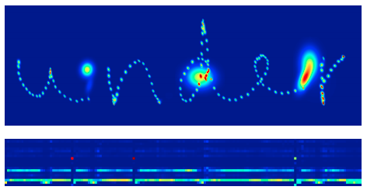
Attending to Arbitrary Regions
- Read text, generate handwriting using an RNN
- Attend to arbitrary regions of the output by predicting params of a mixture model
Graves, “Generating Sequences with Recurrent Neural Networks”, arXiv 2013

Slide 55
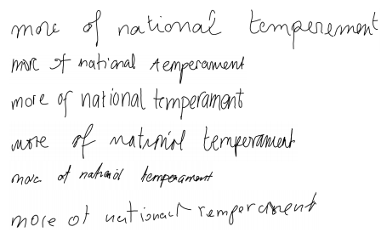
Attending to Arbitrary Regions
- Read text, generate handwriting using an RNN
- Attend to arbitrary regions of the output by predicting params of a mixture model
Which are real and which are generated?
Graves, “Generating Sequences with Recurrent Neural Networks”, arXiv 2013

Slide 56
Attending to Arbitrary Regions
- Read text, generate handwriting using an RNN
- Attend to arbitrary regions of the output by predicting params of a mixture model
Which are real and which are generated?
REAL
Graves, “Generating Sequences with Recurrent Neural Networks”, arXiv 2013
GENERATED

Slide 57
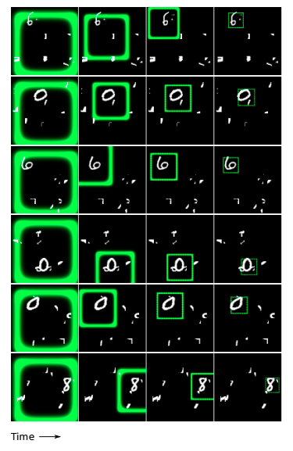
Attending to Arbitrary Regions: DRAW
Classify images by attending to arbitrary regions of the input
Gregor et al, “DRAW: A Recurrent Neural Network For Image Generation”, ICML 2015

Slide 58
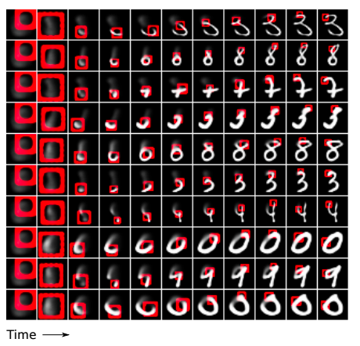
Attending to Arbitrary Regions: DRAW
Classify images by attending to arbitrary regions of the input
Generate images by attending to arbitrary regions of the output
Gregor et al, “DRAW: A Recurrent Neural Network For Image Generation”, ICML 2015

Slide 60
Attending to Arbitrary Regions: Spatial Transformer Networks
Attention mechanism similar to DRAW, but easier to explain
Jaderberg et al, “Spatial Transformer Networks”, NIPS 2015

Slide 61
Spatial Transformer Networks
Input image:
H x W x 3
Cropped and rescaled image:
X x Y x 3
Box Coordinates:
(xc, yc, w, h)
Jaderberg et al, “Spatial Transformer Networks”, NIPS 2015

Slide 62
Spatial Transformer Networks
Can we make this function differentiable?
Input image:
H x W x 3
Cropped and rescaled image:
X x Y x 3
Box Coordinates:
(xc, yc, w, h)
Jaderberg et al, “Spatial Transformer Networks”, NIPS 2015

Slide 63
Spatial Transformer Networks
Idea: Function mapping pixel coordinates (xt, yt) of output to pixel coordinates (xs, ys) of input
Can we make this function differentiable?
Input image:
H x W x 3
Cropped and rescaled image:
X x Y x 3
Box Coordinates:
(xc, yc, w, h)
Jaderberg et al, “Spatial Transformer Networks”, NIPS 2015

Slide 64
Spatial Transformer Networks
Idea: Function mapping pixel coordinates (xt, yt) of output to pixel coordinates (xs, ys) of input
(x^{s}, y^{s})
Can we make this function differentiable?
(x^{t}, y^{t})
Input image:
H x W x 3
Cropped and rescaled image:
X x Y x 3
Box Coordinates:
(xc, yc, w, h)
Jaderberg et al, “Spatial Transformer Networks”, NIPS 2015

Slide 65
Spatial Transformer Networks
Idea: Function mapping pixel coordinates (xt, yt) of output to pixel coordinates (xs, ys) of input
(x^{s}, y^{s})
Can we make this function differentiable?
(x^{t}, y^{t})
Input image:
H x W x 3
Cropped and rescaled image:
X x Y x 3
Box Coordinates:
(xc, yc, w, h)
Jaderberg et al, “Spatial Transformer Networks”, NIPS 2015

Slide 66
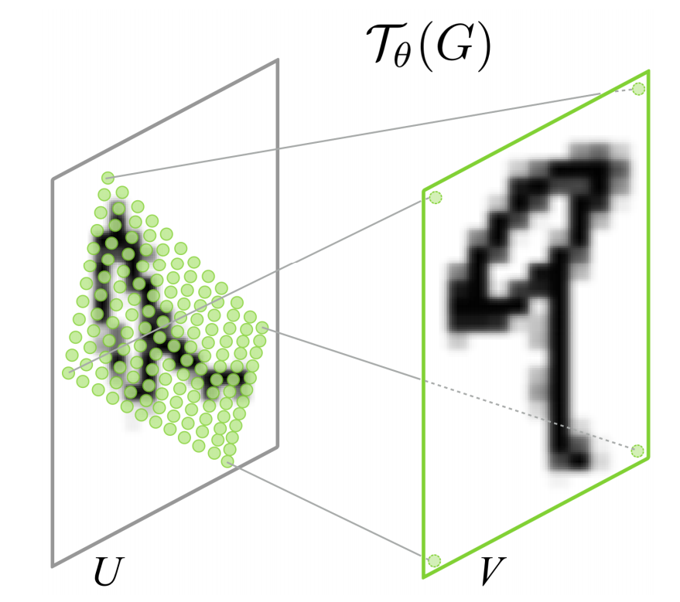
Spatial Transformer Networks
Idea: Function mapping pixel coordinates (xt, yt) of output to pixel coordinates (xs, ys) of input
Can we make this function differentiable?
Input image:
H x W x 3
Repeat for all pixels in output to get a sampling grid
Cropped and rescaled image:
X x Y x 3
Box Coordinates:
(xc, yc, w, h)
Jaderberg et al, “Spatial Transformer Networks”, NIPS 2015

Slide 67
Spatial Transformer Networks
Idea: Function mapping pixel coordinates (xt, yt) of output to pixel coordinates (xs, ys) of input
Can we make this function differentiable?
Input image:
H x W x 3
Repeat for all pixels in output to get a sampling grid
Then use bilinear interpolation to compute output
Cropped and rescaled image:
X x Y x 3
Box Coordinates:
(xc, yc, w, h)
Jaderberg et al, “Spatial Transformer Networks”, NIPS 2015

Slide 68
Spatial Transformer Networks
Idea: Function mapping pixel coordinates (xt, yt) of output to pixel coordinates (xs, ys) of input
Network attends to input by predicting 𝜃
Can we make this function differentiable?
Input image:
H x W x 3
Repeat for all pixels in output to get a sampling grid
Then use bilinear interpolation to compute output
Cropped and rescaled image:
X x Y x 3
Box Coordinates:
(xc, yc, w, h)
Jaderberg et al, “Spatial Transformer Networks”, NIPS 2015

Slide 69
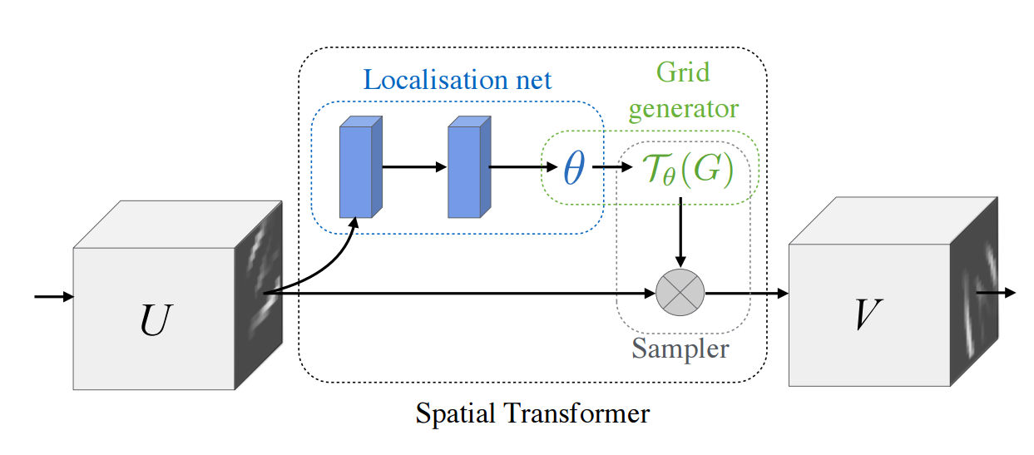
Spatial Transformer Networks
Input: Full image
Output: Region of interest from input

Slide 70
Spatial Transformer Networks
A small Localization network predicts transform 𝜃
Input: Full image
Output: Region of interest from input

Slide 71
Spatial Transformer Networks
Grid generator uses 𝜃 to compute sampling grid
A small Localization network predicts transform 𝜃
Input: Full image
Output: Region of interest from input

Slide 72
Spatial Transformer Networks
Grid generator uses 𝜃 to compute sampling grid
A small Localization network predicts transform 𝜃
Input: Full image
Output: Region of interest from input
Sampler uses bilinear interpolation to produce output

Slide 73
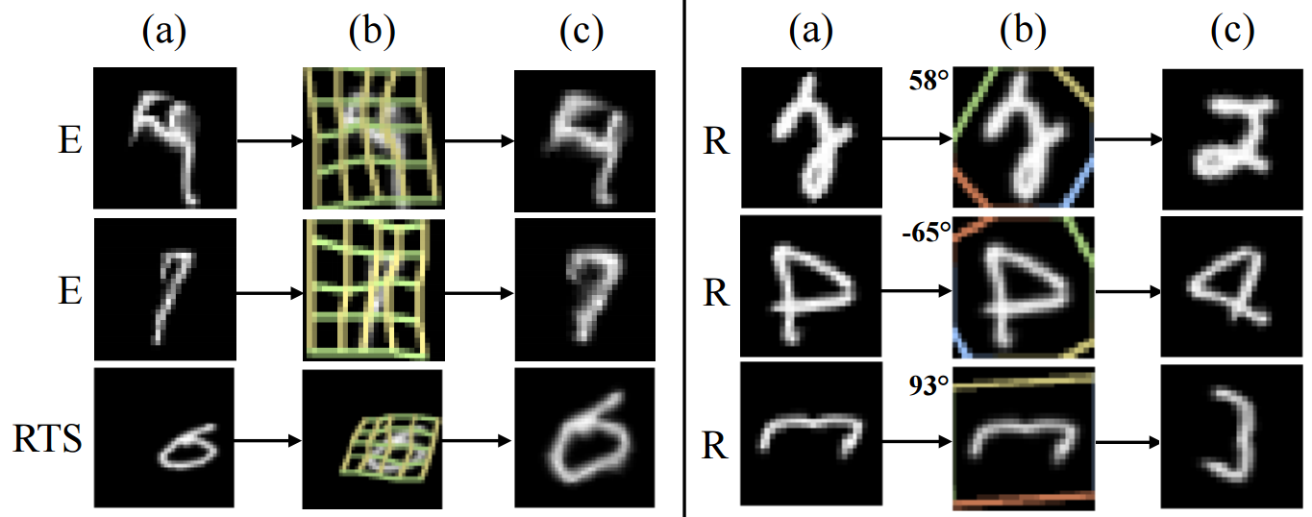
Spatial Transformer Networks
Insert spatial transformers into a classification network and it learns to attend and transform the input
Differentiable “attention / transformation” module

Slide 75
Attention Takeaways
Performance:
Attention models can improve accuracy and reduce computation at the same time.
Complexity:
There are many design choices.
Those choices have a big effect on performance.
Ensembling has unusually large benefits.
Simplify where possible!

Slide 76
Attention Takeaways
Explainability:
Attention models encode explanations.
Both locus and trajectory help understand what’s going on.
Hard vs. Soft:
Soft models are easier to train, hard models require reinforcement learning.
They can be combined, as in Luong et al.

